Slide 1
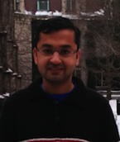
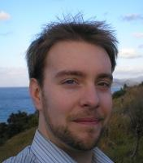
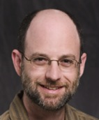
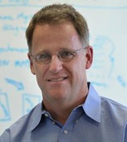
Swift/T: Dataflow Composition of Tcl Scripts for Petascale Computing
Justin M Wozniak
Argonne National Laboratory and University of Chicago
http://swift-lang.org/Swift-T wozniak@mcs.anl.gov

Slide 2
scientific workflows
Big picture: solutions for scientific scripting

Slide 3
The Scientific Computing Campaign
The Swift system addresses most of these components
Primarily a language, with a supporting runtime and toolkit
THINK about what to run next
RUN a battery of tasks
IMPROVE methods and codes
COLLECT results

Slide 4
Goals of the Swift language
Swift was designed to handle many aspects of the computing campaign
Ability to integrate many application components into a new workflow application
Data structures for complex data organization
Portability- separate site-specific configuration from application logic
Logging, provenance, and plotting features
THINK
RUN
IMPROVE
COLLECT

Slide 5
Goal: Programmability for large scale computing
Approach: Many-task computing: Higher-level applications composed of many run-to-completion tasks: input→compute→output
Programmability
Large number of applications have this natural structure at upper levels: Parameter studies, ensembles, Monte Carlo, branch-and-bound, stochastic programming, UQ
Easy way to exploit hardware concurrency
Experiment management
Address workflow-scale issues: data transfer, application invocation

Slide 6
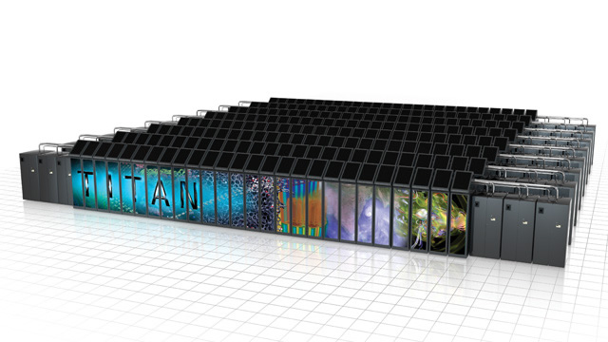
The Race to Exascale
TOP500 leaderboard
The exaflop computer: a quintillion (10¹⁸) floating point operations per second
Expected to have massive (billion-way) concurrency
Significant issues must be overcome
Fault-tolerance
I/O
Heat and power efficiency
Programmability!
Can scripting systems like Tcl help?
I think so!
#1 Tianhe-2: 33 PF, 18 MW (China)
#2 Titan: 20 PF, 8 MW (Oak Ridge)
#5 Mira: 8.5 PF, 4 MW (Argonne)
= 2.5 MW

Slide 7
Outline
Introduction to Swift/T
Introduction to MPI
Introduction to ADLB
Introduction to Turbine, the Swift/T runtime
Use of Tcl in Swift/T
Interesting Swift/T features
Applications
Performance

Slide 8
Swift/T OVERVIEW
High-performance dataflow for compositional programming

Slide 9
Swift programming model: all progress driven by concurrent dataflow
(int r) myproc (int i, int j)
{
int x = A(i);
int y = B(j);
r = x + y;
}
A() and B() implemented in native code
A() and B()run in concurrently in different processes
r is computed when they are both done
This parallelism is automatic
Works recursively throughout the program’s call graph

Slide 10
Swift programming model
Data types
int i = 4;
int A[];
string s = "hello world";
Mapped data types
file image<"snapshot.jpg">;
Structured data
image A[]<array_mapper…>;
type protein {
file pdb;
file docking_pocket;
}
bag<blob>[] B;
Conventional expressions
if (x == 3) {
y = x+2;
s = sprintf("y: %i", y);
}
Parallel loops
foreach f,i in A {
B[i] = convert(A[i]);
}
Implicit data flow
merge(analyze(B[0], B[1]),
analyze(B[2], B[3]));
Swift: A language for distributed parallel scripting, J. Parallel Computing, 2011

Slide 11
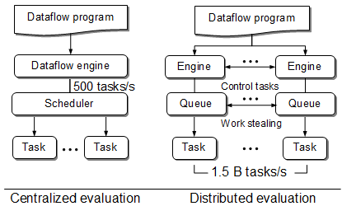
Swift/T: Swift for high-performance computing
For extreme scale, we need this: (Swift/T)
Had this:
(Swift/K)
Wozniak et al. Swift/T: Scalable data flow programming for distributed-memory task-parallel applications . Proc. CCGrid, 2013.

Slide 12
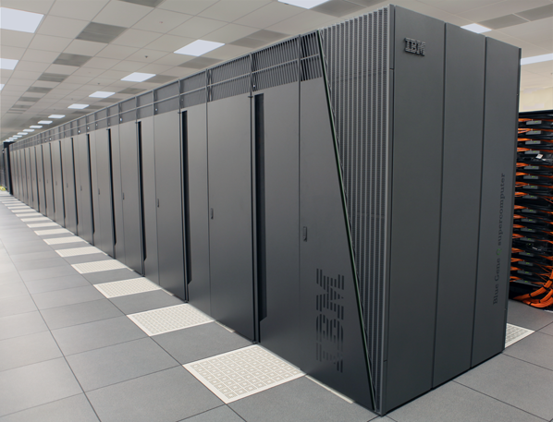
Original implementation: Swift/K (c. 2006) - scripting for distributed computing Still maintained and supported
10¹⁸
Submit host (login node, laptop, Linux server)
Swift
script
10¹⁵
Application
Programs
Clouds:
Amazon EC2, XSEDE Wispy, …
Data server
Swift/K runs parallel scripts on a broad range of parallel computing resources
Notes:
12

Slide 13
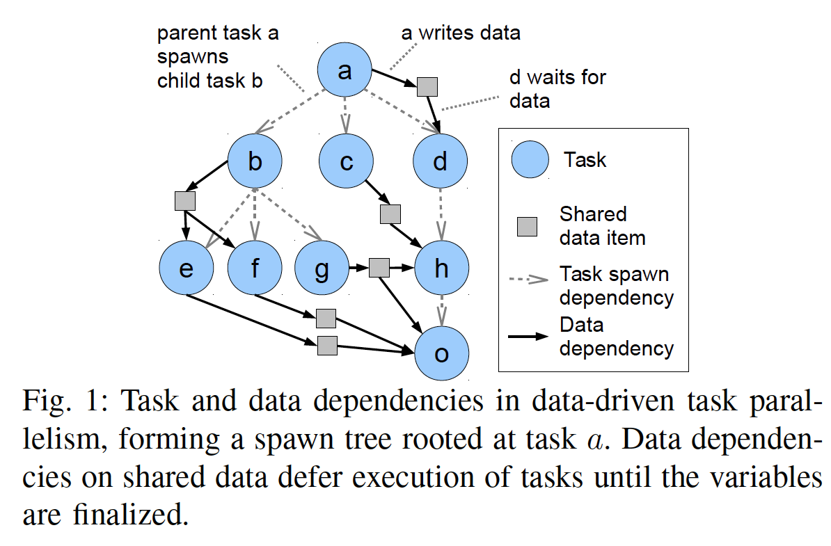
Pervasive parallel data flow
Simple dataflow DAG on scalars
Does not capture generality of scientific computing and analysis ensembles:
Optimization-directed iterations
Conditional execution
Reductions

Slide 14
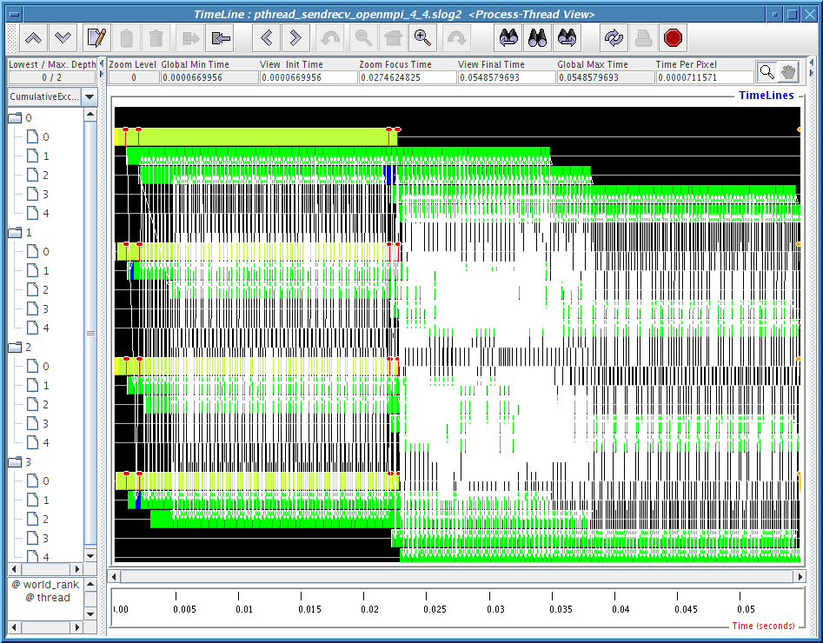
MPI: The Message Passing Interface
Programming model used on large supercomputers
Can run on many networks, including sockets, or shared memory
Standard API for C and Fortran, other languages have working implementations
Contains communication calls for
Point-to-point (send/recv)
Collectives (broadcast, reduce, etc.)
Interesting concepts
Communicators: collections of communicating processing and a context
Data types: Language-independent data marshaling scheme

Slide 15
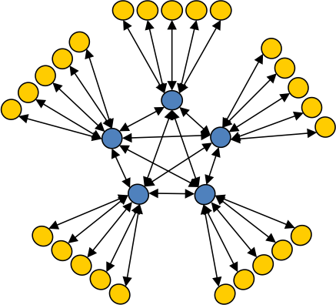
ADLB: Asynchronous Dynamic Load Balancer
An MPI library for master-worker workloads in C
Uses a variable-size, scalable network of servers
Servers implement work-stealing
The work unit is a byte array
Optional work priorities, targets, types
For Swift/T, we added:
Server-stored data
Data-dependent execution
Tcl bindings!
Workers
Servers
Lusk et al. More scalability, less pain: A simple programming model and its implementation for extreme computing. SciDAC Review 17, 2010.

Slide 16
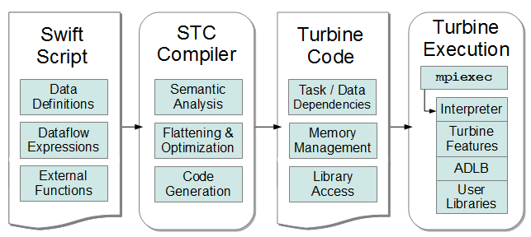
Swift/T Compiler and Runtime
STC translates high-level Swift expressions into low-level Turbine operations:
Create/Store/Retrieve typed data
Manage arrays
Manage data-dependent tasks
Wozniak et al. Large-scale application composition via distributed-memory data flow processing. Proc. CCGrid 2013.
Armstrong et al. Compiler techniques for massively scalable implicit task parallelism. Proc. SC 2014.

Slide 17
Turbine Code is Tcl
Why Tcl?
Needed a simple, textual compiler target for STC
Needed to be able to post code into ADLB
Needed to be able to easily call C (ADLB and user code)
Turbine
Includes the Tcl bindings for ADLB
Builtins to implement Swift primitives in Tcl (arithmetic, string operations, etc.)
Swift/T Compiler (STC)
A Java program based on ANTLR
Generates Tcl (contains a Tcl abstract syntax tree API in Java)
Performs variable usage analysis and optimization

Slide 18
Distributed Data-dependent Execution
STC can generate arbitrary Tcl but Swift requires dataflow processing
Implemented this requirement in the Turbine rule statement
Rule syntax:
rule [ list inputs ] "action string" options…
All Swift data is registered with the ADLB distributed data store
Rules post data-dependent tasks in ADLB
When all inputs are stored, the action string is released
The action string is a Tcl fragment

Slide 19
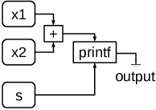
Translation from Swift to Turbine
Swift:
Turbine/Tcl:
x1 = 3;
s = "value: ";
x2 = 2;
int x3;
printf("%s%i", s, x3);
x3 = x1+x2;
STC
literal x1 integer 3
literal s string "value: "
literal x2 integer 2
allocate x3 integer
rule [ list $x3 ] "puts \[retrieve $s\]\[retrieve $x3\]"
rule [ list $x1 $x2 ] \
"store_integer $x3 \[expr \[retrieve $x1\]+\[retrieve $x2\]\]"
Tcl variables contain TDs (addresses)

Slide 20
Interacting with the Tcl Layer
Can easily specify a fragment of Tcl to access:
Automatically loads the given Tcl package/version (turbine 0.0)
STC substitutes Tcl variables with the <<·>> syntax
Typically want to simply reference some greater Tcl or native code library
(int c) add(int a, int b) "turbine" "0.0" [
"set <<c>> [ expr <<a>> + <<b>> ]"
];

Slide 21
Example distributed execution
A[2] = f(getenv(“N”));
Code
Evaluate dataflow operations
Workers: execute tasks
A[3] = g(A[2]);
Perform getenv()
Submit f
Subscribe to A[2]
Submit g
Task put
Task put
Task get
Task get
Notification
Process f
Store A[2]
Process g
Store A[3]
Wozniak et al. Turbine: A distributed-memory dataflow engine for high performance many-task applications. Fundamenta Informaticae 128(3), 2013

Slide 22
Examples!

Slide 23
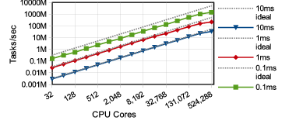
Extreme scalability for small tasks
1.5 billion tasks/s on 512K cores of Blue Waters, so far
Armstrong et al. Compiler techniques for massively scalable implicit task parallelism. Proc. SC 2014.

Slide 24
Characteristics of very large Swift programs
int X = 100, Y = 100;
int A[][];
int B[];
foreach x in [0:X-1] {
foreach y in [0:Y-1] {
if (check(x, y)) {
A[x][y] = g(f(x), f(y));
} else {
A[x][y] = 0;
}
}
B[x] = sum(A[x]);
}
The goal is to support billion-way concurrency: O(10⁹)
Swift script logic will control trillions of variables and data dependent tasks
Need to distribute Swift logic processing over the HPC compute system

Slide 25
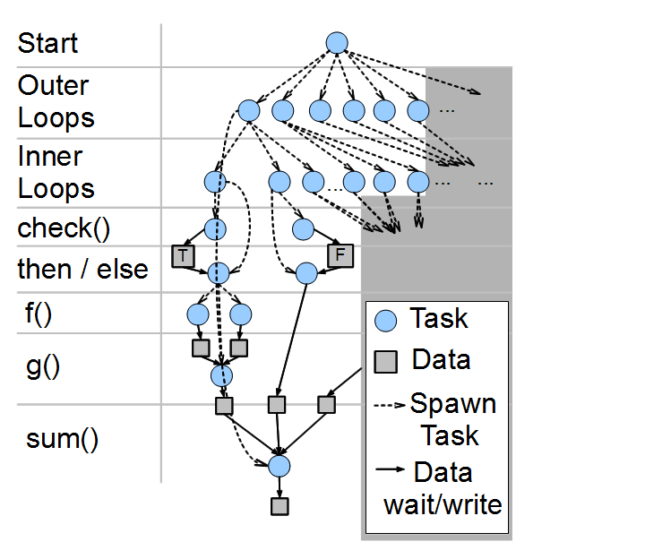
Swift/T: Fully parallel evaluation of complex scripts
int X = 100, Y = 100;
int A[][];
int B[];
foreach x in [0:X-1] {
foreach y in [0:Y-1] {
if (check(x, y)) {
A[x][y] = g(f(x), f(y));
} else {
A[x][y] = 0;
}
}
B[x] = sum(A[x]);
}
Wozniak et al. Large-scale application composition via distributed-memory data flow processing. Proc. CCGrid 2013.

Slide 26
Swift code in dataflow
Dataflow definitions create nodes in the dataflow graph
Dataflow assignments create edges
In typical (DAG) workflow languages, this forms a static graph
In Swift, the graph can grow dynamically – code fragments are evaluated (conditionally) as a result of dataflow
Data dependent-tasks are managed by ADLB
x = g();
if (x > 0) {
n = f(x);
foreach i in [0:n-1] {
output(p(i));
}}
x = g();
x
if (x > 0) { n = f(x); …
n
foreach i … {
output(p(i));
output(p(i));
output(p(i));

Slide 27
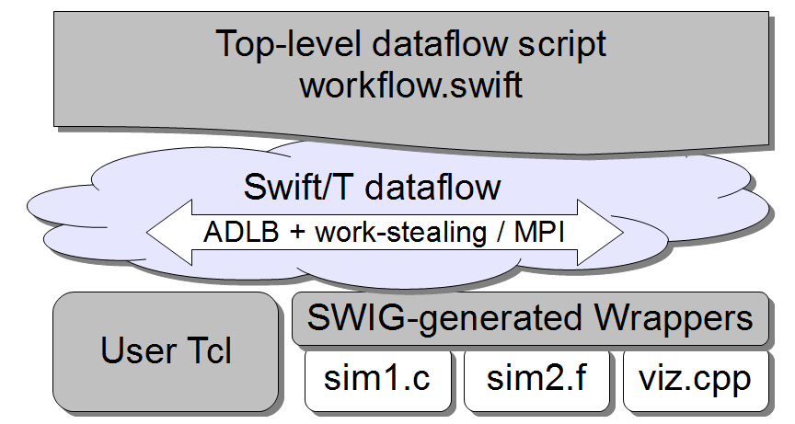
Hierarchical programming model
Including MPI libraries

Slide 28
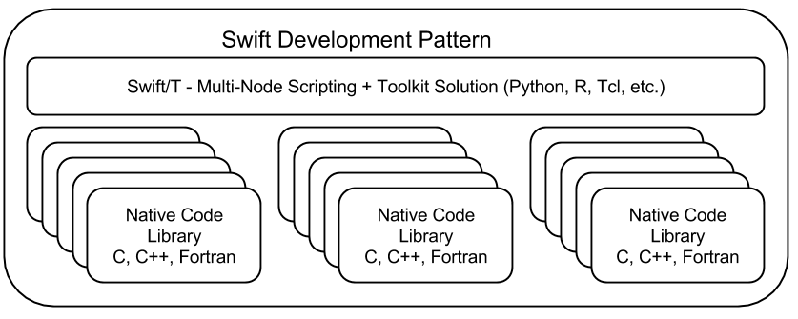
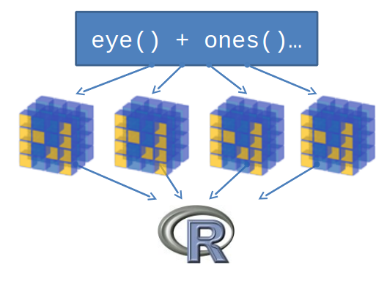
Support calls to embedded interpreters
We have plugins for Python, R, Tcl, Julia, and QtScript
Wozniak et al. Toward computational experiment management via multi-language applications. Proc. ASCR SWP4XS, 2014.
Wozniak et al. Interlanguage parallel scripting for distributed-memory scientific computing. Proc. CLUSTER 2015.

Slide 29
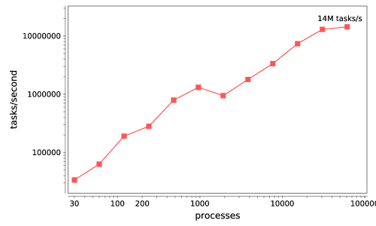
Swift/T: Enabling high-performance scripting
Write site-independent scripts in Swift language
Execute on scalable runtime: Turbine
Automatic parallelization and data movement
Run native code or script fragments as application tasks
Rapidly subdivide large partitions for MPI libraries using MPI 3
Swift/T worker
Swift/T control process
Swift worker process
Swift control process
Swift control process
C
C++
Fortran
C
C++
Fortran
C
C++
Fortran
MPI
64K cores of Blue Waters
2 billion Python tasks 14 million Pythons/s

Slide 30
novel features: runtime
Swift/T features for task control

Slide 31
Task priorities
User-written annotation on function call
Priorities are best-effort and are relative to tasks on a given ADLB server
Could be used to:
Promote tasks that release lots of other dependent work
Compute more important work early (before allocation expires!)
Deal with trailing tasks (next slide)
foreach i in 0:N-1 {
@prio=i f(i); }

Slide 32
Prioritize long-running tasks
Variable-sized tasks produce trailing tasks: addressed by exposing ADLB task priorities at language level

Slide 33
Stateful external interpreters
Desire to use high-level, 3rd party algorithms in Python, R to orchestrate Swift workflows, e.g.:
Python DEAP for evolutionary algorithms
R language GA package
Typical control pattern:
GA minimizes the cost function
You pass the cost function to the library and wait
We want Swift to obtain the parameters from the library
We launch a stateful interpreter on a thread
The "cost function" is a dummy that returns the parameters to Swift over IPC
Swift passes the real cost function results back to the library over IPC
Achieve high productivity and high scalability
Library is not modified – unaware of framework!
Application logic extensions in high-level script
MPI Process
Load balancing
MPI
Swift worker
Python/R
Tasks
Results
IPC
GA

Slide 34
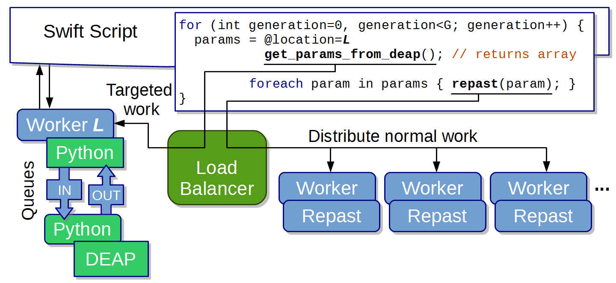
Unnecessary details: Epidemics ensembles
Epidemic simulators
Wozniak et al. Many Resident Task Computing in Support of Dynamic Ensemble Computations. Proc. MTAGS 2015.

Slide 35
Ebola spread modeling
Epidemic analysis- combining agent-based models with observation
Received emergency funding late last year
Combines Python-based evolutionary algorithm with high-performance agent-based epidemic modeling code
Want to compare simulations with observations in real-time as disease spreads through a population

Slide 36
Features for Big Data analysis
Location-aware scheduling User and runtime coordinate data/task locations
Collective I/O User and runtime coordinate data/task locations
Application Location annotations
Application I/O hook
Runtime MPI-IO transfers
Runtime Hard/soft locations
Cache FS
Distributed data
Parallel FS
Distributed data
F. Duro et al. Exploiting data locality in Swift/T workflows using Hercules . Proc. NESUS Workshop, 2014.
Wozniak et al. Big data staging with MPI-IO for interactive X-ray science. Proc. Big Data Computing, 2014.

Slide 37
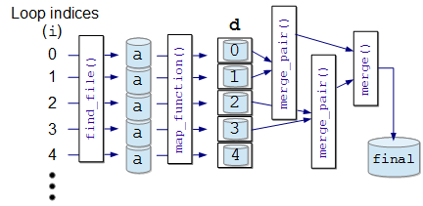
Abstract, extensible MapReduce in Swift
main {
file d[];
int N = string2int(argv("N"));
// Map phase
foreach i in [0:N-1] {
file a = find_file(i);
d[i] = map_function(a);
}
// Reduce phase
file final <"final.data"> = merge(d, 0, tasks-1);
}
(file o) merge(file d[], int start, int stop) {
if (stop-start == 1) {
// Base case: merge pair
o = merge_pair(d[start], d[stop]);
} else {
// Merge pair of recursive calls
n = stop-start;
s = n % 2;
o = merge_pair(merge(d, start, start+s),
merge(d, start+s+1, stop));
}}
User needs to implement map_function() and merge()
These may be implemented in native code, Python, etc.
Could add annotations
Could add additional custom application logic

Slide 38
Hercules
Want to run arbitrary workflows over distributed filesystems that expose data locations: Hercules is based on Memcached
Data analytics, post-processing
Exceed generality MapReduce: without losing data optimizations
Can optionally send a Swift task to a particular location with simple syntax:
Can obtain ranks from hostnames: int rank = hostmapOneWorkerRank("my.host.edu");
Can now specify location constraints: location L = location(rank, HARD|SOFT, RANK|NODE);
Much more to be done here!
foreach i in 0:N-1 {
location L = locationFromRank(i);
@location=L f(i); }

Slide 39
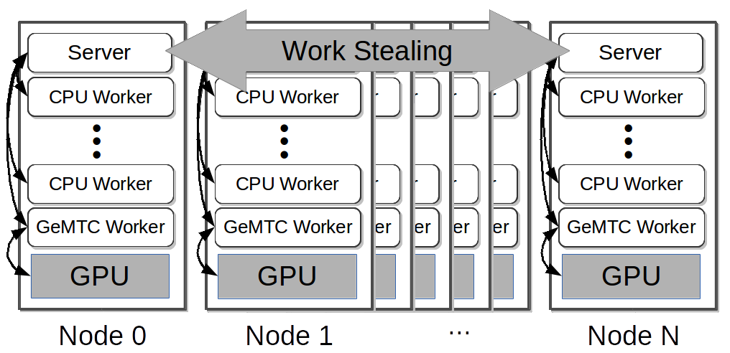
GeMTC: GPU-enabled Many-Task Computing
Motivation: Support for MTC on all accelerators!
Goals:
1) MTC support 2) Programmability
3) Efficiency 4) MPMD on SIMD
5) Increase concurrency to warp level
Approach:
Design & implement GeMTC middleware:
1) Manages GPU 2) Spread host/device
3) Workflow system integration (Swift/T)

Slide 40
Logging and debugging
What just happened?

Slide 41
Logging and debugging in Swift
Traditionally, Swift programs are debugged through the log or the TUI (text user interface)
Logs were produced using normal methods, containing:
Variable names and values as set with respect to thread
Calls to Swift functions
Calls to application code
A restart log could be produced to restart a large Swift run after certain fault conditions
Methods require single Swift site: do not scale to larger runs

Slide 42
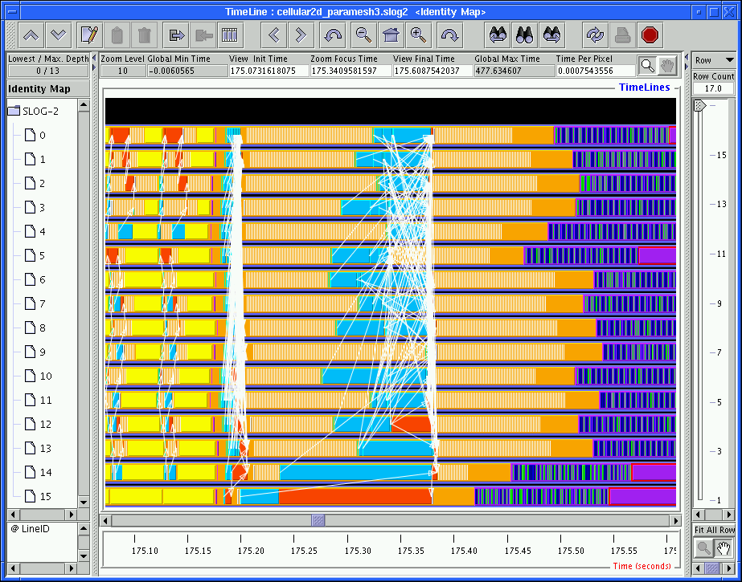
Logging in MPI
The Message Passing Environment (MPE)
Common approach to logging MPI programs
Can log MPI calls or application events – can store arbitrary data
Can visualize log with Jumpshot
Partial logs are stored at the site of each process
Written as necessary to shared file system
in large blocks
in parallel
Results are merged into a big log file (CLOG, SLOG)
Work has been done optimize the file format for various queries

Slide 43
Logging in Swift & MPI
Now, combine it together
Allows user to track down erroneous Swift program logic
Use MPE to log data, task operations, calls to native code
Use MPE metadata to annotate events for later queries
MPE cannot be used to debug native MPI programs that abort
On program abort, the MPE log is not flushed from the process-local cache
Cannot reconstruct final fatal events
MPE can be used to debug Swift application programs that abort
We finalize MPE before aborting Swift
(Does not help much when developing Swift itself)
But primary use case is non-fatal arithmetic/logic errors
Wozniak et al. A model for tracing and debugging large-scale task-parallel programs with MPE. Proc LASH-C, 2013.

Slide 44
Visualization of Swift/T execution
User writes and runs Swift script
Notices that native application code is called with nonsensical inputs
Turns on MPE logging – visualizes with MPE
PIPS task computation Store variable Notification (via control task) Blue: Get next task Retrieve variable Server process (handling of control task is highlighted in yellow)
Color cluster is task transition:
Simpler than visualizing messaging pattern (which is not the user’s code!)
Represents Von Neumann computing model – load, compute, store
Process rank
Time
Jumpshot view of PIPS application run

Slide 45
Debugging Swift/T execution
Starting from GUI, user can identify erroneous task
Uses time and rank coordinates from task metadata
Can identify variables used as task inputs
Can trace provenance of those variables back in reverse dataflow
erroneous task
Aha! Found script defect.
← ← ← (searching backwards)

Slide 46
Applications
Molecular dynamics simulation, X-ray science data processing

Slide 47
Can we build a Makefile in Swift?
User wants to test a variety of compiler optimizations
Compile set of codes under wide range of possible configurations
Run each compiled code to obtain performance numbers
Run this at large scale on a supercomputer (Cray XE6)
In Make you say: CFLAGS = ... f.o : f.c gcc $(CFLAGS) f.c -o f.o In Swift you say: string cflags[] = ...; f_o = gcc(f_c, cflags);

Slide 48
CHEW example code
Apps app (object_file o) gcc(c_file c, string cflags[]) {
// Example:
// gcc -c -O2 -o f.o f.c
"gcc" "-c" cflags "-o" o c;
}
app (x_file x) ld(object_file o[], string ldflags[]) {
// Example:
// gcc -o f.x f1.o f2.o ...
"gcc" ldflags "-o" x o;
}
app (output_file o) run(x_file x) {
"sh" "-c" x @stdout=o;
}
app (timing_file t) extract(output_file o) {
"tail" "-1" o "|" "cut" "-f" "2" "-d" " " @stdout=t;
}
Swift code
string program_name = "programs/program1.c";
c_file c = input(program_name);
// For each
foreach O_level in [0:3] {
make file names…
// Construct compiler flags
string O_flag = sprintf("-O%i", O_level);
string cflags[] = [ "-fPIC", O_flag ];
object_file o<my_object> = gcc(c, cflags);
object_file objects[] = [ o ];
string ldflags[] = [];
// Link the program
x_file x<my_executable> = ld(objects, ldflags);
// Run the program
output_file out<my_output> = run(x);
// Extract the run time from the program output
timing_file t<my_time> = extract(out);

Slide 49
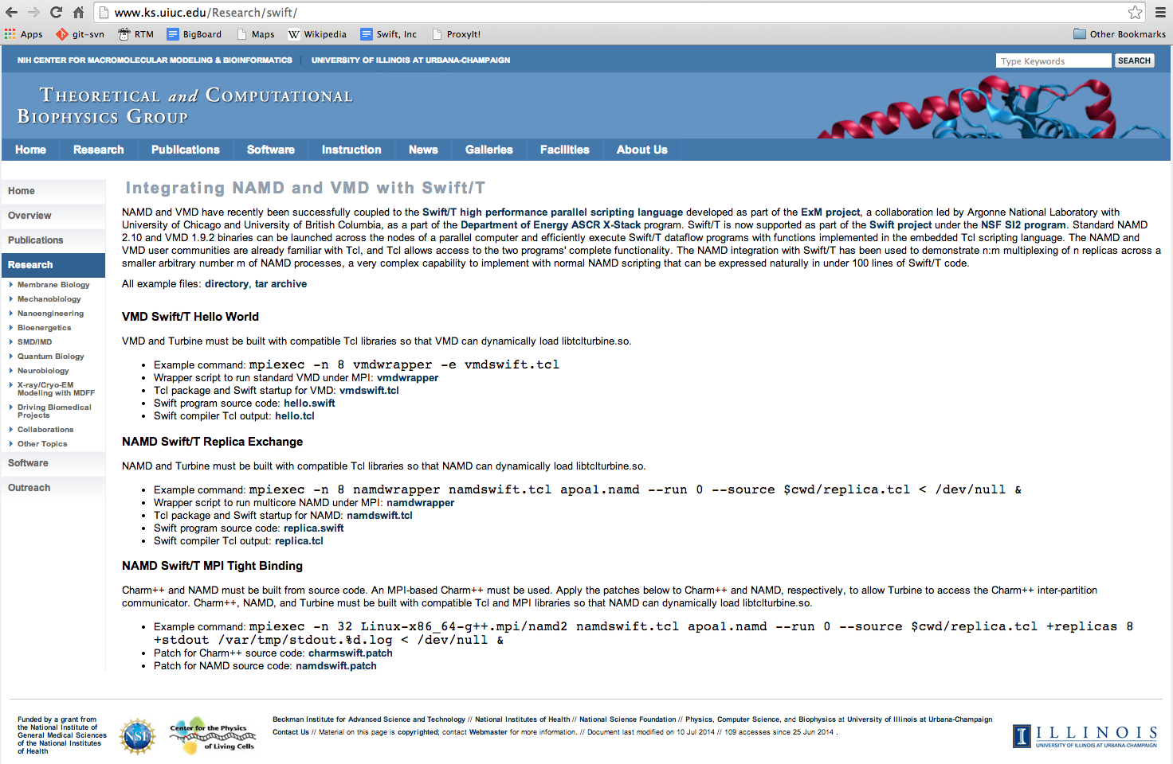
Swift integration into NAMD and VMD
www.ks.uiuc.edu/Research/swift
See Dalke and Schulten, Using Tcl for Molecular Visualization and Analysis, 1997.

Slide 50
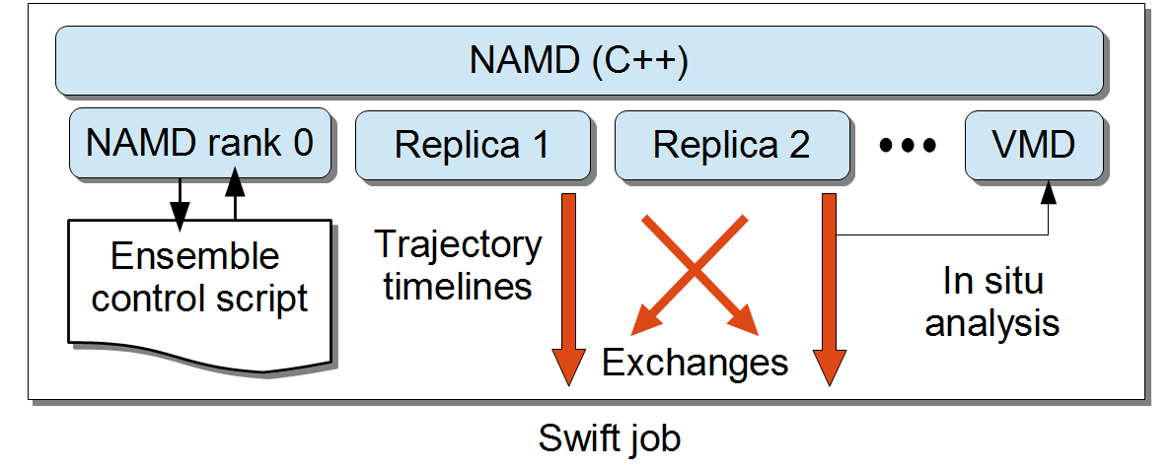
NAMD Replica Exchange Limitations
One-to-one replicas to Charm++ partitions:
Available hardware must match science.
Batch job size must match science.
Replica count fixed at job startup.
No hiding of inter-replica communication latency.
No hiding of replica performance divergence.
Can a different programming model help?

Slide 51
Benefits of using Swift within NAMD / VMD
Work by Jim Phillips and John Stone of UIUC NAMD Group (Schulten Lab) :
NAMD 2.10 and VMD 1.9.2 can run Swift dataflow programs using functions from their embedded Tcl scripting language.
NAMD and VMD users are already familiar with Tcl, and Tcl allows access to the two apps’ complete functionality.
Swift has been used to demonstrate n:m multiplexing of n replicas across a smaller arbitrary number m of NAMD processes
This is very complex to do with normal NAMD scripting that can be expressed naturally in under 100 lines of Swift/T code.

Slide 52
NAMD/VMD and Swift/T
Typical Swift/T Structure
NAMD/VMD Structure

Slide 53
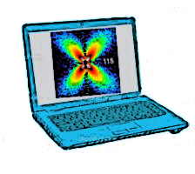
Future work: Extreme scale ensembles
Enhance Swift for exascale experiment/simulate/analyze ensembles
Deploy stateful, varying sized jobs
Outermost, experiment-level coordination via dataflow
Plug in experiments and human-in-the-loop models (dataflow filters)
JointLab collaboration: Connecting bulk task-task data transfer with Swift
APS
Big job 1: Type A
Big job 2: Type A
Big job 3: Type B
Small job 1: Type A
Small job 2: Type A
Small job 3: Type B
Small job 4: Type B
Small job 4: Type C
Small job 5: Type D

Slide 54
Technology transfer – Parallel.Works
An incubation venture of the University of Chicago’s CIE: Chicago Innovation Exchange http://cie.uchicago.edu

Slide 55
Technology transfer – Parallel.Works

Slide 56
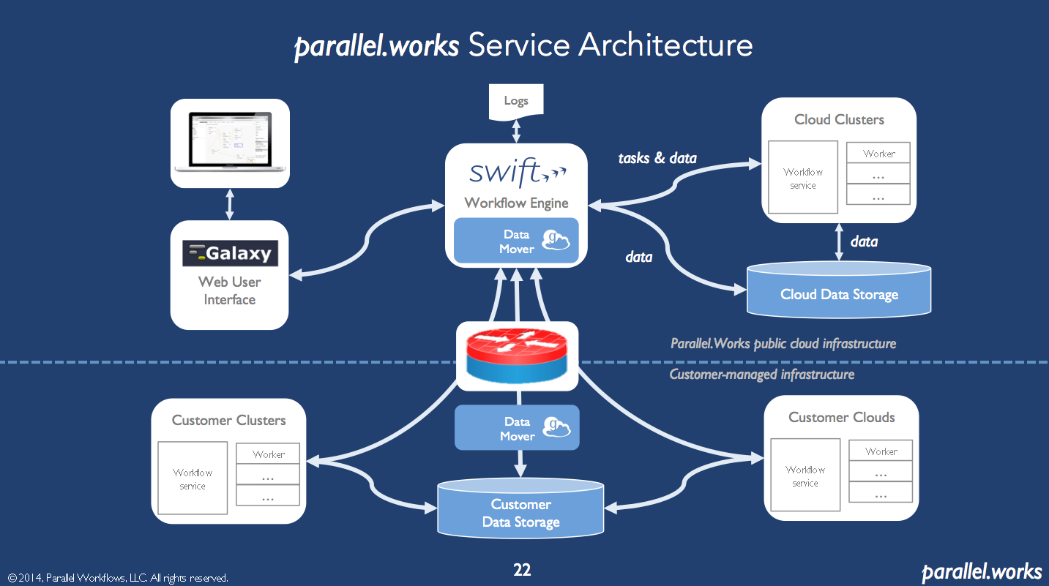
Technology transfer – Parallel.Works

Slide 57
Summary
Swift: High-level scripting for outermost programming constructs
Heavily based on Tcl!
Described novel features for task control and big data computing on clusters and supercomputers
Thanks to the Swift team: Mike Wilde, Ketan Maheshwari, Tim Armstrong, David Kelly, Yadu Nand, Mihael Hategan, Scott Krieder, Ioan Raicu, Dan Katz, Ian Foster
Thanks to the Tcl organizers
Questions?
THINK
RUN
IMPROVE
COLLECT

