Slide 1
Streaming, Storing, and Sharing Big Data for Light Source Science
Justin M Wozniak <wozniak@mcs.anl.gov>
Kyle Chard, Ben Blaiszik, Michael Wilde, Ian Foster
Argonne National Laboratory
At STREAM 2015
Oct. 27, 2015

Slide 2
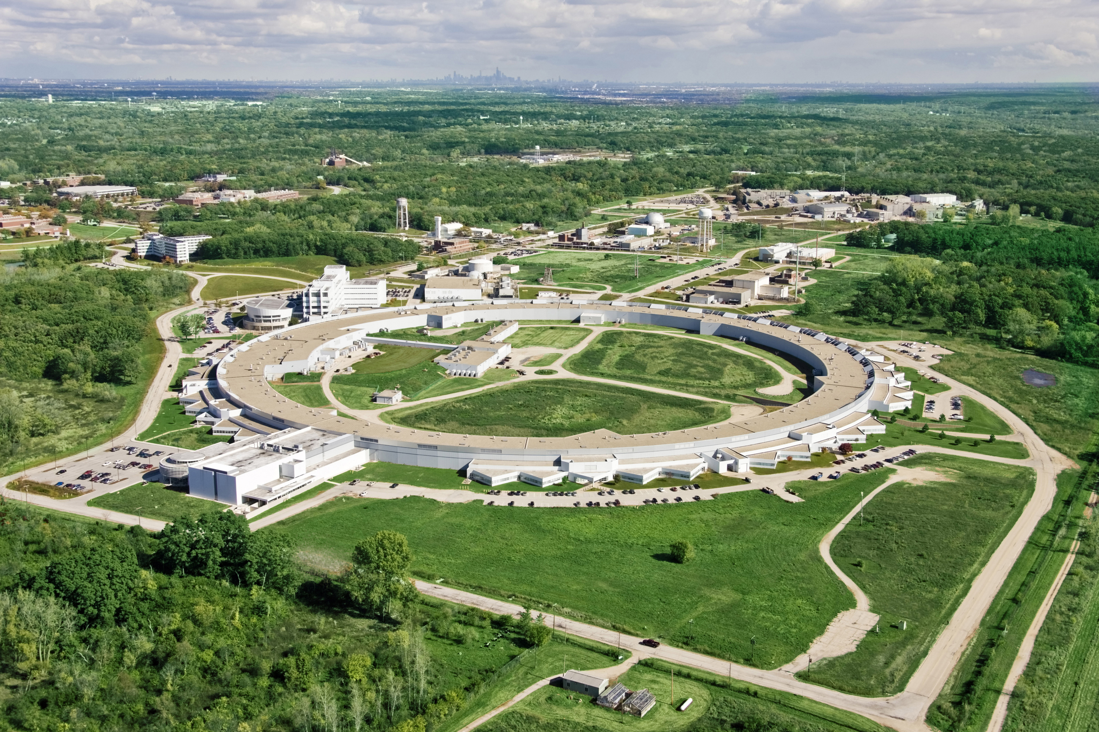
Chicago
Supercomputers
Advanced Photon Source (APS)

Slide 3
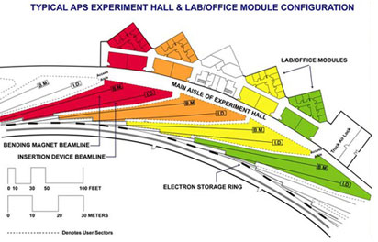
Advanced Photon Source (APS)
Moves electrons at electrons at >99.999999% of the speed of light.
Magnets bend electron trajectories, producing x-rays, highly focused onto a small area
X-rays strike targets in 35 different laboratories – each a lead-lined, radiation-proof experiment station
Scattering detectors produce images containing experimental results

Slide 4
Distance from Top Light Sources to
Top Supercomputer Centers
Light Source | Distance to Top10 Machine
SIRIUS, Brazil | > 5000Km, TACC, USA
BAP, China | 2000Km, Tihane-2, China
MAX, Sweden | 800Km, Jülich Germany
PETRA III, Germany | 500Km, Jülich Germany
ESRF, France | 400Km, Lugano, Switzerland
Spring 8, Japan | 100Km, K-Machine, Kobe, Japan
APS, IL, USA | ~1Km, ALCF & MCS*, ANL, USA
*ANL Computing Divisions
ALCF: Argonne Leadership Computing Facility
MCS: Mathematics & Computer Science

Slide 5
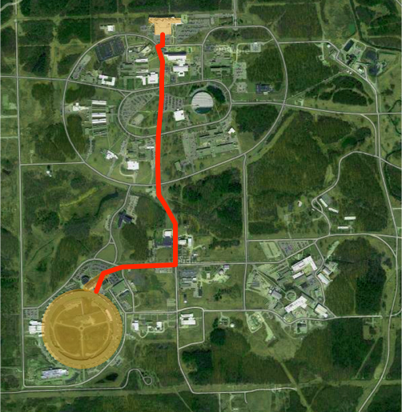
Proximity means
we can closely
couple computing
in novel ways
Terabits/s in the
near future
Petabits/s
are possible
ALCF
MCS
APS

Slide 6
TALK overview
Goals and tools

Slide 7
Goals
Automated data capture and analysis pipelines
To boost productivity during beamtime
Integration with high-performance computers
To integrate experiment and simulation
Effective use of large data sets
Maximize utility of high-resolution, high-frame-rate detectors and automation
High interactivity and programmability
Improve the overall scientific process

Slide 8
Tools
Swift
Workflow language with very high scalability
Globus Catalog
Annotation system for distributed data
Globus Transfer
Parallel data movement system
NeXpy/NXFS
GUI with connectivity to Catalog and Python remote object services

Slide 9
SwifT
High performance workflows

Slide 10
Goals of the Swift language
Swift was designed to handle many aspects of the computing campaign
Ability to integrate many application components into a new workflow application
Data structures for complex data organization
Portability- separate site-specific configuration from application logic
Logging, provenance, and
plotting features
Today, we will focus on running scripted
applications on large streaming data sets
THINK
RUN
IMPROVE
COLLECT

Slide 11
Swift programming model:
All progress driven by concurrent dataflow
(int r) myproc (int i, int j)
{
int x = A(i);
int y = B(j);
r = x + y;
}
A() and B() implemented in native code
A() and B()run in concurrently in different processes
r is computed when they are both done
This parallelism is automatic
Works recursively throughout the program’s call graph

Slide 12
Swift programming model
Data types
int i = 4;
int A[];
string s = "hello world";
Mapped data types
file image<"snapshot.jpg">;
Structured data
image A[]<array_mapper…>;
type protein {
file pdb;
file docking_pocket;
}
protein p<ext; exec=protein.map>;
Conventional expressions
if (x == 3) {
y = x+2;
s = strcat("y: ", y);
}
Parallel loops
foreach f,i in A {
B[i] = convert(A[i]);
}
Data flow
merge(analyze(B[0], B[1]),
analyze(B[2], B[3]));
Swift: A language for distributed parallel scripting. J. Parallel Computing, 2011

Slide 13
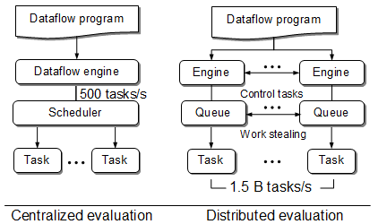
Swift/T: Distributed dataflow processing
Had this:
(Swift/K)
For extreme scale,
we need this:
(Swift/T)
Armstrong et al. Compiler techniques for massively scalable implicit task parallelism. Proc. SC 2014.
Wozniak et al. Swift/T: Scalable data flow programming for distributed-memory task-parallel applications . Proc. CCGrid, 2013.

Slide 14

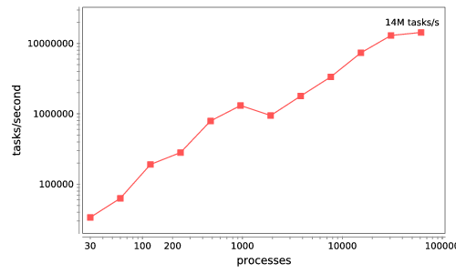




Swift/T: Enabling high-performance workflows
Write site-independent scripts
Automatic parallelization and data movement
Run native code, script fragments as applications
Swift/T worker
64K cores of Blue Waters
2 billion Python tasks
14 million Pythons/s
Swift/T control process
Swift worker process
Swift control process
Swift control process
C
C++
Fortran
C
C++
Fortran
C
C++
Fortran
MPI
Wozniak et al. Interlanguage parallel scripting for distributed-memory scientific computing. Proc. WORKS 2015.

Slide 15
Features for Big Data analysis
Location-aware scheduling
User and runtime coordinate data/task locations
Collective I/O
User and runtime coordinate data/task locations
Application
I/O hook
Application
Dataflow,
annotations
Runtime
MPI-IO transfers
Runtime
Hard/soft locations
Distributed data
Distributed data
Parallel FS
F. Duro et al. Exploiting data locality in Swift/T workflows using Hercules.
Proc. NESUS Workshop, 2014.
Wozniak et al. Big data staging with MPI-IO for interactive X-ray science.
Proc. Big Data Computing, 2014.

Slide 16
Next steps for streaming analysis
Integrated streaming solution
Combine parallel transfers and stages with distributed in-memory caches
Parallel, hierarchical data ingest
Implement fast bulk transfers from experiment to variably-sized ad hoc caches
Retain high programmability
Provide familiar programming interfaces
Application
Analysis tasks
Runtime
MPI-IO transfers
HPC
Distributed data
Parallel Transfers
APS
Detector
Data Facility
Distributed stage (RAM)
Bulk Transfers

Slide 17
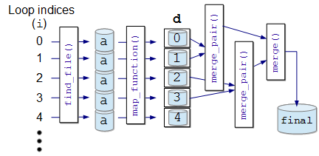
Abstract, extensible MapReduce in Swift
main {
file d[];
int N = string2int(argv("N"));
// Map phase
foreach i in [0:N-1] {
file a = find_file(i);
d[i] = map_function(a);
}
// Reduce phase
file final <"final.data"> = merge(d, 0, tasks-1);
}
(file o) merge(file d[], int start, int stop) {
if (stop-start == 1) {
// Base case: merge pair
o = merge_pair(d[start], d[stop]);
} else {
// Merge pair of recursive calls
n = stop-start;
s = n % 2;
o = merge_pair(merge(d, start, start+s),
merge(d, start+s+1, stop));
}}
User needs to implement
map_function() and merge()
These may be implemented
in native code, Python, etc.
Could add annotations
Could add additional custom
application logic

Slide 18
Hercules/Swift
Want to run arbitrary workflows over distributed filesystems that expose data locations: Hercules is based on Memcached
  Data analytics, post-processing
  Exceed the generality of MapReduce without losing data optimizations
Can optionally send a Swift task to a particular location with simple syntax:
Can obtain ranks from hostnames:
int rank = hostmapOneWorkerRank("my.host.edu");
Can now specify location constraints:
location L = location(rank, HARD|SOFT, RANK|NODE);
Much more to be done here!
foreach i in [0:N-1] {
location L = locationFromRank(i);
@location=L f(i);
}

Slide 19
Globus catalog
Annotation system for distributed scientific data

Slide 20
Catalog Goals
Group data based on use, not location
  Logical grouping to organize, reorganize, search, and describe usage
Annotate with characteristics that reflect content …
  Capture as much existing information as possible
  Share datasets for collaboration- user access control
Operate on datasets as units
Research data lifecycle is continuous and iterative:
  Metadata is created (automatically and manually) throughout
  Data provenance and linkage between raw and derived data
Most often:
  Data is grouped and acted on collectively
    Views (slices) may change depending on activity
  Data and metadata changes over time
  Access permissions are important (and also change)

Slide 21
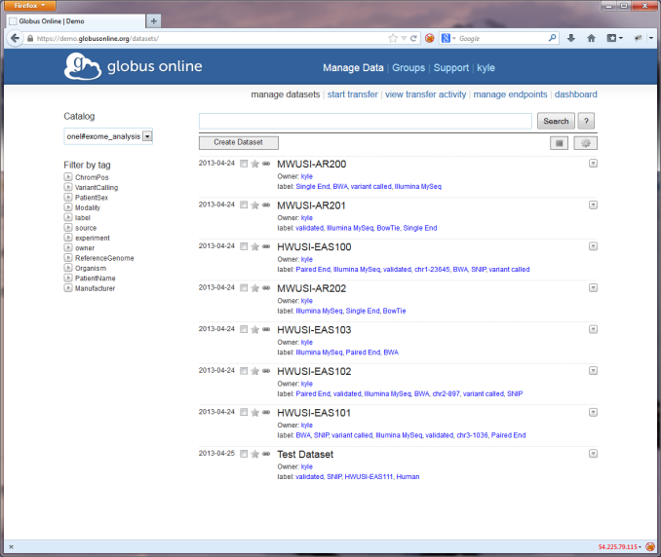
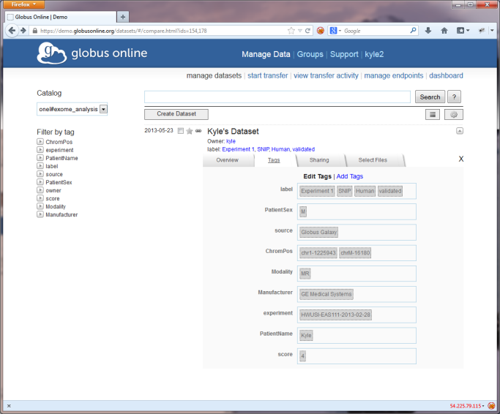
Catalog Data Model
Catalog: a hosted resource that enables the grouping of related datasets
Dataset: a virtual collection of (schema-less) metadata and distributed data elements
Annotation: a piece of metadata that exists within the context of a dataset or data member
  Specified as key-value pairs
Member: a specific data item (file, directory) associated with a dataset

Slide 22
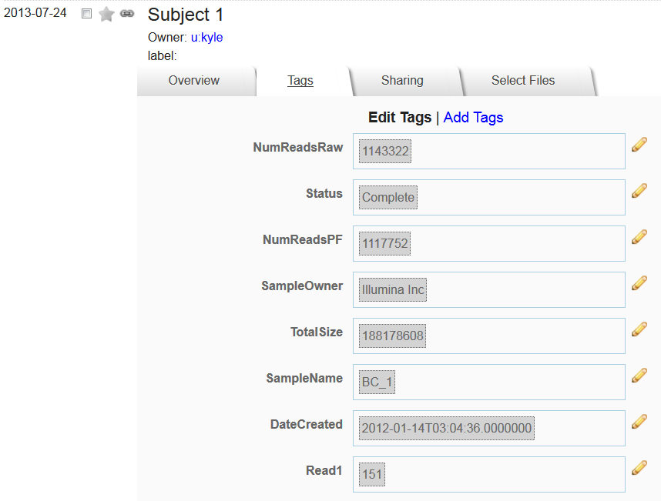
Web interface for annotations

Slide 23
Globus transfer
High-speed wide area data transfers

Slide 24







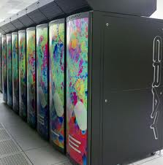
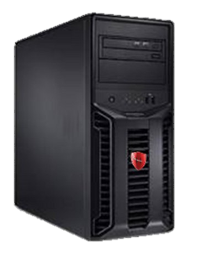

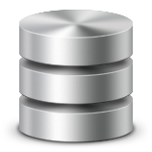
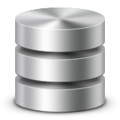
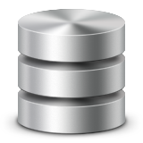












Globus Transfer
Supercomputers and Campus Clusters
Personal Resources
Object Storage
Block/Drive Storage
Instance Storage
Globus Connect
Globus Connect
Globus Connect
Globus Connect
Globus Endpoints
Globus Nexus
InCommon/CILogon
Transfer
Synchronize
OpenID
Share
MyProxy OAuth

Slide 25


Globus Transfer
Reliable, secure, high-performance file transfer and synchronization
“Fire-and-forget” transfers
Automatic fault recovery
Seamless security integration
10x faster than SCP
2
Globus moves and syncs files
Data
Source
Data
Destination
1
User initiates transfer request
3
Globus notifies user

Slide 26
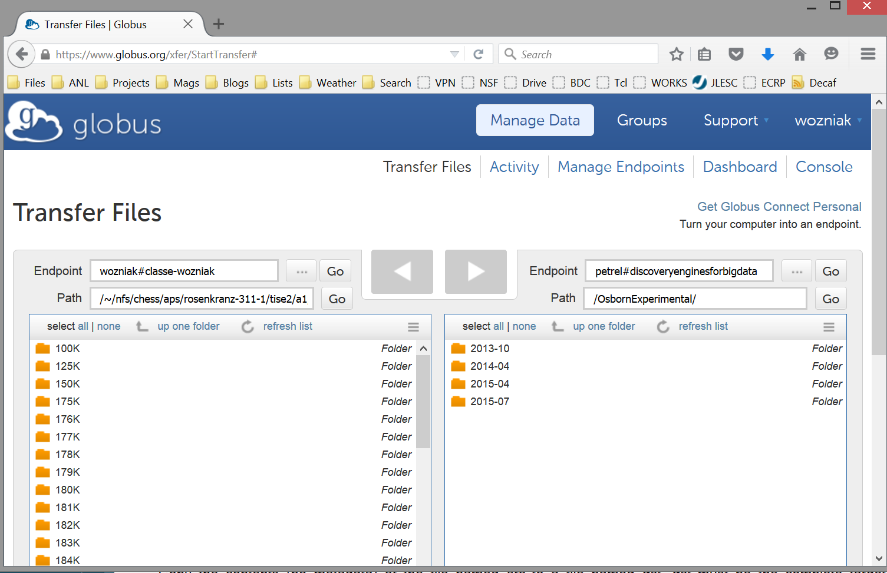
Globus Transfer: CHESS to ALCF
K. Dedrick. Argonne group sets record for largest X-ray dataset ever at CHESS. News at CHESS, Oct. 2015.

Slide 27

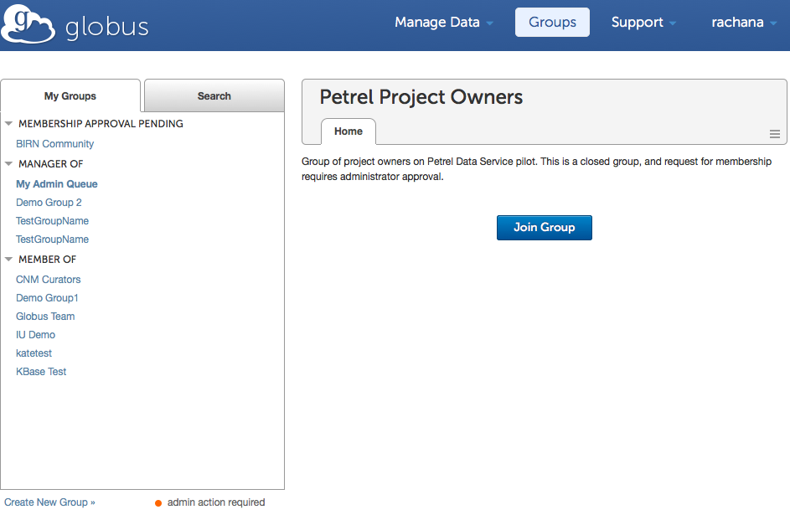
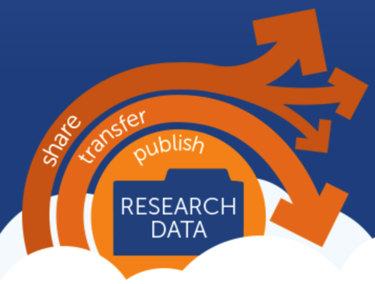
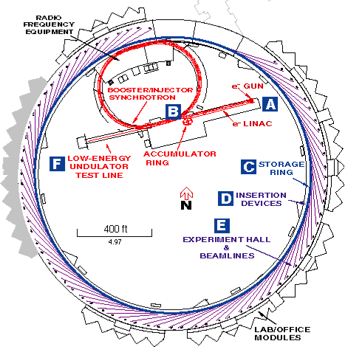
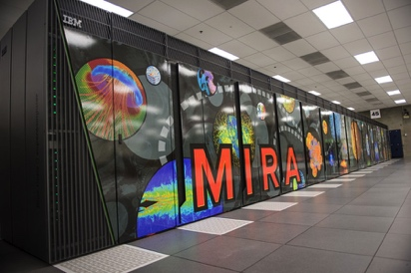
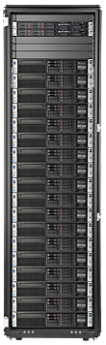
The Petrel research data service
High-speed, high-capacity data store
Seamless integration with data fabric
Project-focused, self-managed
globus.org
100 TB allocations
User managed access
Other sites, facilities, colleagues
3 GB/s network
32 I/O nodes with GridFTP
1.7 PB GPFS store
Notes:
A uniform data fabric across the lab
… with seamless access to large data…
… for use in computation, collaboration and distribution …
… that is project focused and self managed …
… and is described and discoverable

Slide 28
Nexpy / nxfs
Rapid and remote structured data visualization

Slide 29
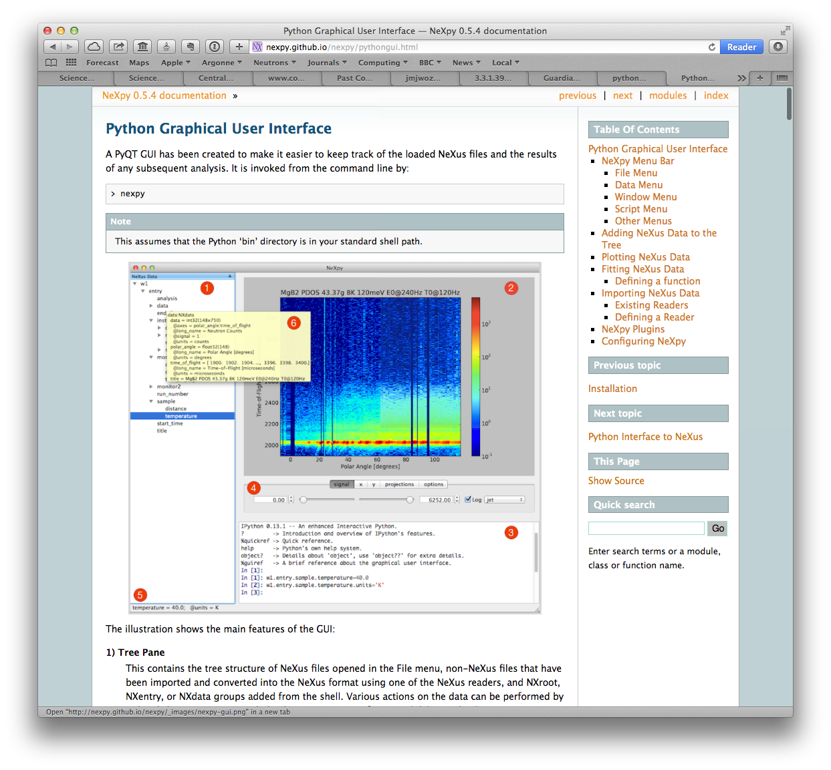




NeXpy: A Python Toolbox for Big Data
A toolbox for manipulating and visualizing arbitrary NeXus data of any size
A scripting engine for GUI applications
A portal to Globus Catalog
A demonstration of the value of combining:
  a flexible data model
  a powerful scripting language
http://nexpy.github.io/nexpy
$ pip install nexpy
=
+

Slide 30
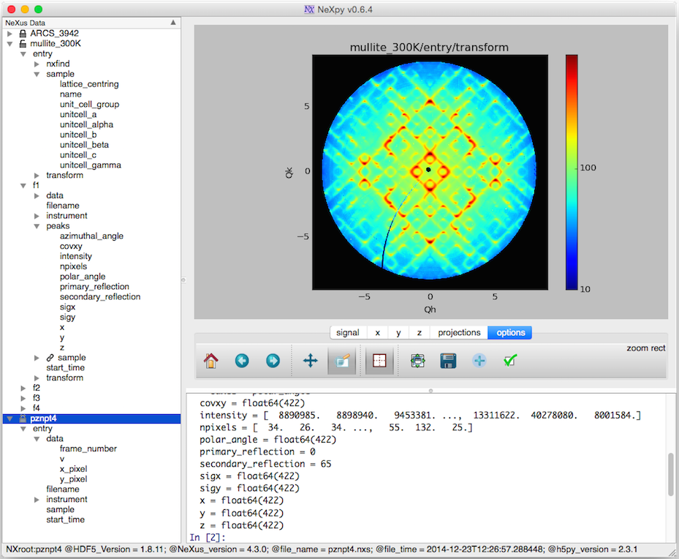
Mullite

Slide 31
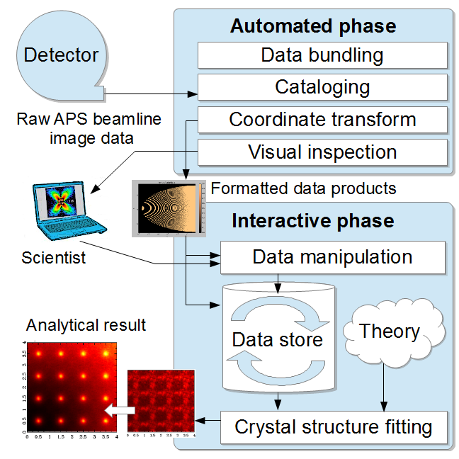
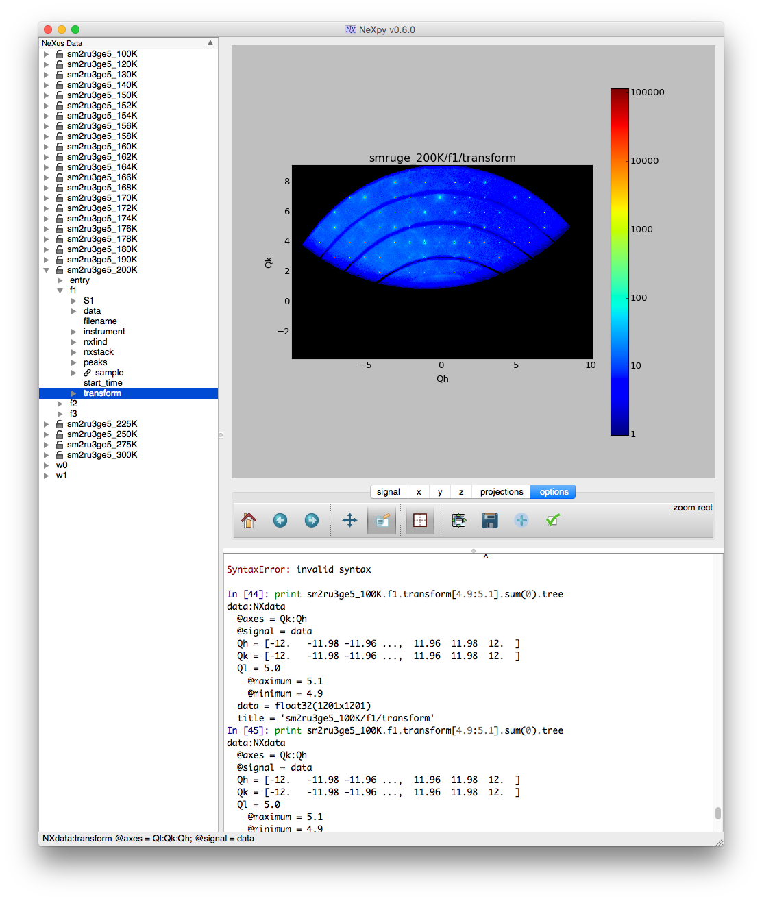
NeXpy in the Pipeline
Use of NeXpy throughout the analysis pipeline

Slide 32
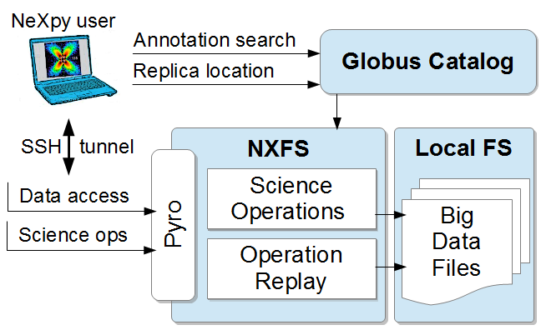
The NeXus File Service (NXFS)
Wozniak et al. Big data remote access interfaces for light source science. Proc. Big Data Computing, 2015.

Slide 33
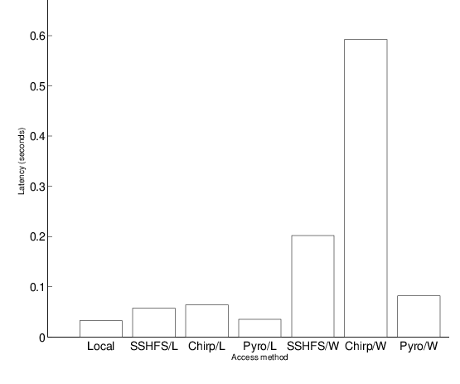
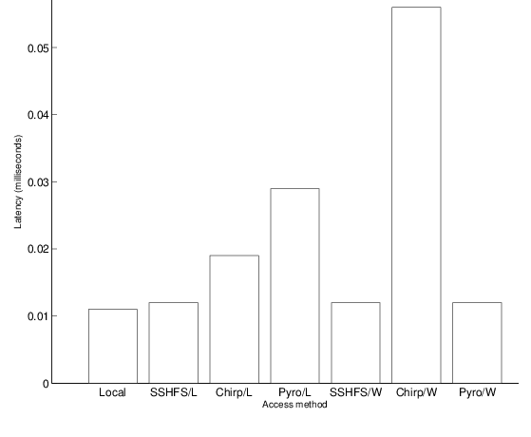
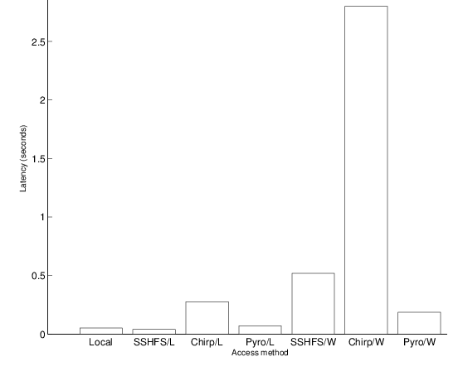
NXFS Performance
Faster than application-agnostic remote filesystem technologies
  Compared Pyro to Chirp and SSHFS from inside ANL (L) and AWS EC2 (W)
Plus ability to invoke remote methods!
File open (10⁻¹s)
Metadata read (10⁻²s)
Pixel read (1s)
Operation and Time Scale

Slide 34
Case study: NF-HEDM
Near Field – High Energy Diffraction Microscopy
Collaboration with APS Sector 1: Jon Almer, Hemant Sharma, et al.

Slide 35
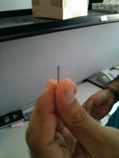
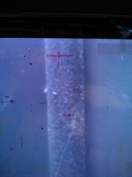
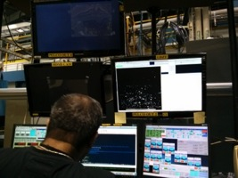
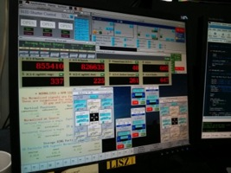
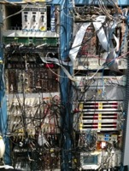
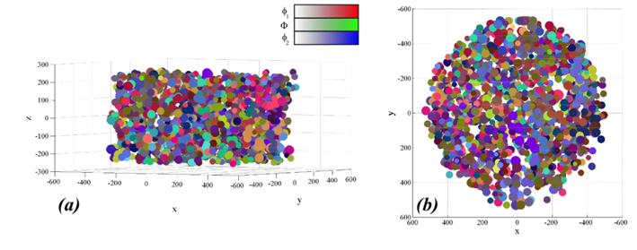
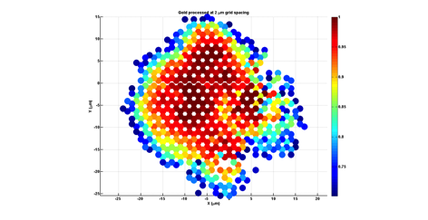
Determining the crystal structure of metals non-destructively

Slide 36
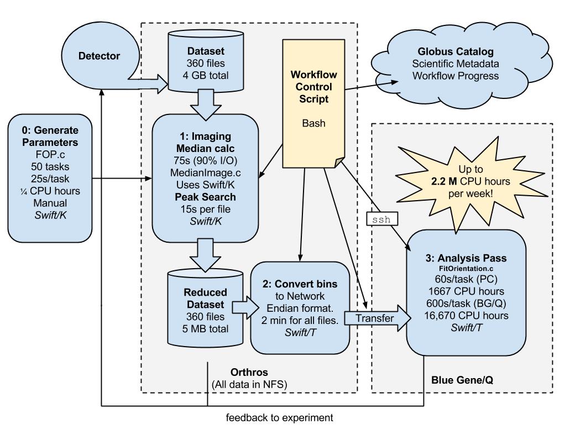
NF-HEDM

Slide 37
High-Energy Diffraction Microscopy
Near-field high-energy diffraction microscopy discovers metal grain shapes and structures
The experimental results are greatly improved with the application of Swift-based cluster computing (RED indicates higher confidence in results)
October 2013: Without Swift
April 2014: With Swift

Slide 38
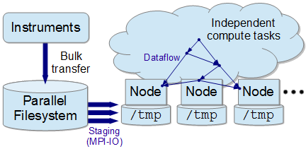
Big picture: Task-based HPC on Big Data
Existing C code assembled into scalable HPC program with Swift/T
Problem: Each task must consumes ~500 MB of experimental data
Runs on the Blue Gene/Q
Relevant to Big Data – HPC convergence
Could use Swift/T data locality annotations for high-level, data
location-aware programming

Slide 39
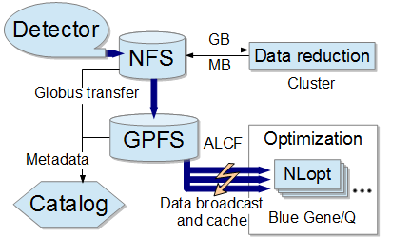
Intended use of broadcast operation
Grain orientation optimization workflow runs on BG/Q once data is there
Each task needs to read all input from a given dataset
Desire to use MPI-IO before running tasks

Slide 40
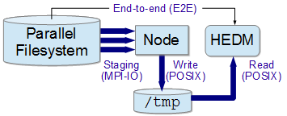
Big Data Staging with MPI-IO
Solution: Broadcast experimental data on HPC system with MPI-IO
Tasks consume data normally from node-local storage

Slide 41
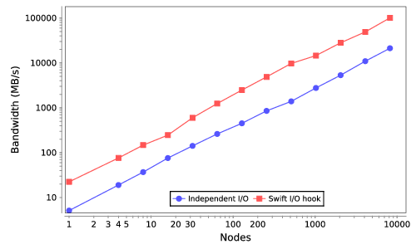
Scalability result: End-to-end
101 GB/s
21 GB/s
8K cores

Slide 42
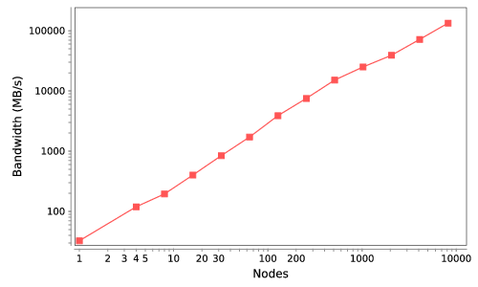
Scalability result: Stage+Write
134 GB/s
8K cores
This plot breaks I/O hook into 1) stage+write and 2) read phases
Read phase is node-local: consistently 10.8 ±0.1 s

Slide 43
NF-HEDM: Conclusions
Blue Gene/Q can be used for big data problems and a many-task programming model
  Just broadcast the data to compute nodes first with MPI-IO
The Swift I/O hook enables efficient I/O in a many-task model
  Reduces I/O time by factor of 4.7!
Connecting HPC to a real-time experiment saved an experiment by detecting a loose cable
Code is now being reused by about 5 different groups
  Now must accommodate extra users on HPC resources!

Slide 44
Summary
Described Big Data + HPC application: X-ray crystallography
Described four relevant tools:
  Swift
  Globus Catalog
Described path forward, integrating tools for streaming workflows
Thanks to the organizers
Thanks to our application collaborators
Questions?
  Globus Transfer
  NeXpy/NXFS
http://swift-lang.org

