Slide 1
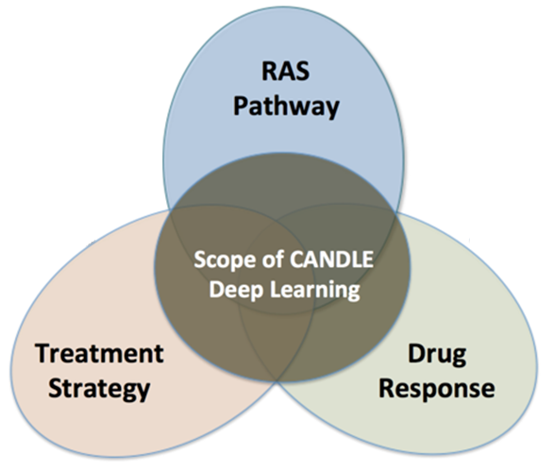
An Automation Framework for Comparison of Cancer Response Models Across Configurations
Scalable workflows for deep learning
drhgfdjhngngfmhgmghmghjmghfmf
Justin m wozniak, Rajeev Jain, Andreas Wilke, Rylie Weaver, Alexander Partin, Thomas Brettin, and Rick Stevens
Data science & Learning Argonne National Laboratory
eScience, Limassol October 13, 2023

Slide 2
OUTLINE
Overview of ECP CANDLE
Computing environment
CANDLE/Supervisor framework
Workflow technologies
Model curation – The IMPROVE project
Model comparison
Results from the Uno model across two datasets

Slide 3
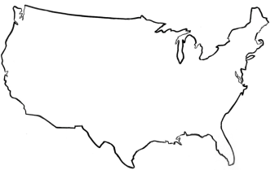
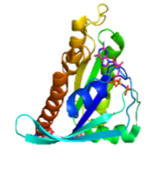
CANDLE: Application goals
Deliver high performance tools and techniques to partners in cancer research
Achieve and demonstrate utility of exascale hardware on cancer problems
Focus on “Benchmarks” developed by other projects (some same personnel)
Apply extreme parallelism to application-level problems
Exascale
technologies driving advances
NCI
National Cancer Institute
DOE
Department
of Energy
Cancer driving computing advances
Clinical Domain – Precision oncology surveillance
Expanded SEER database information capture
Modeling patient health trajectories
Pre-clinical Domain – Improved predictive models
Computational/hybrid predictive models of drug response
Improved experimental design
Molecular Domain – Multiscale biological models
Models for RAS-RAS complex interactions
Insight into RAS related cancers

Slide 4
Deep learning on supercomputers
Steep learning curve with myriad technologies
Workflow manager (Swift/T, EMEWS) ; Scheduler ; scripting
Deep learning (Keras, TensorFlow, Horovod)
Optimization algorithms (R, Python)
MPI implementation (MVAPICH, Open MPI)
etc. …

Slide 5
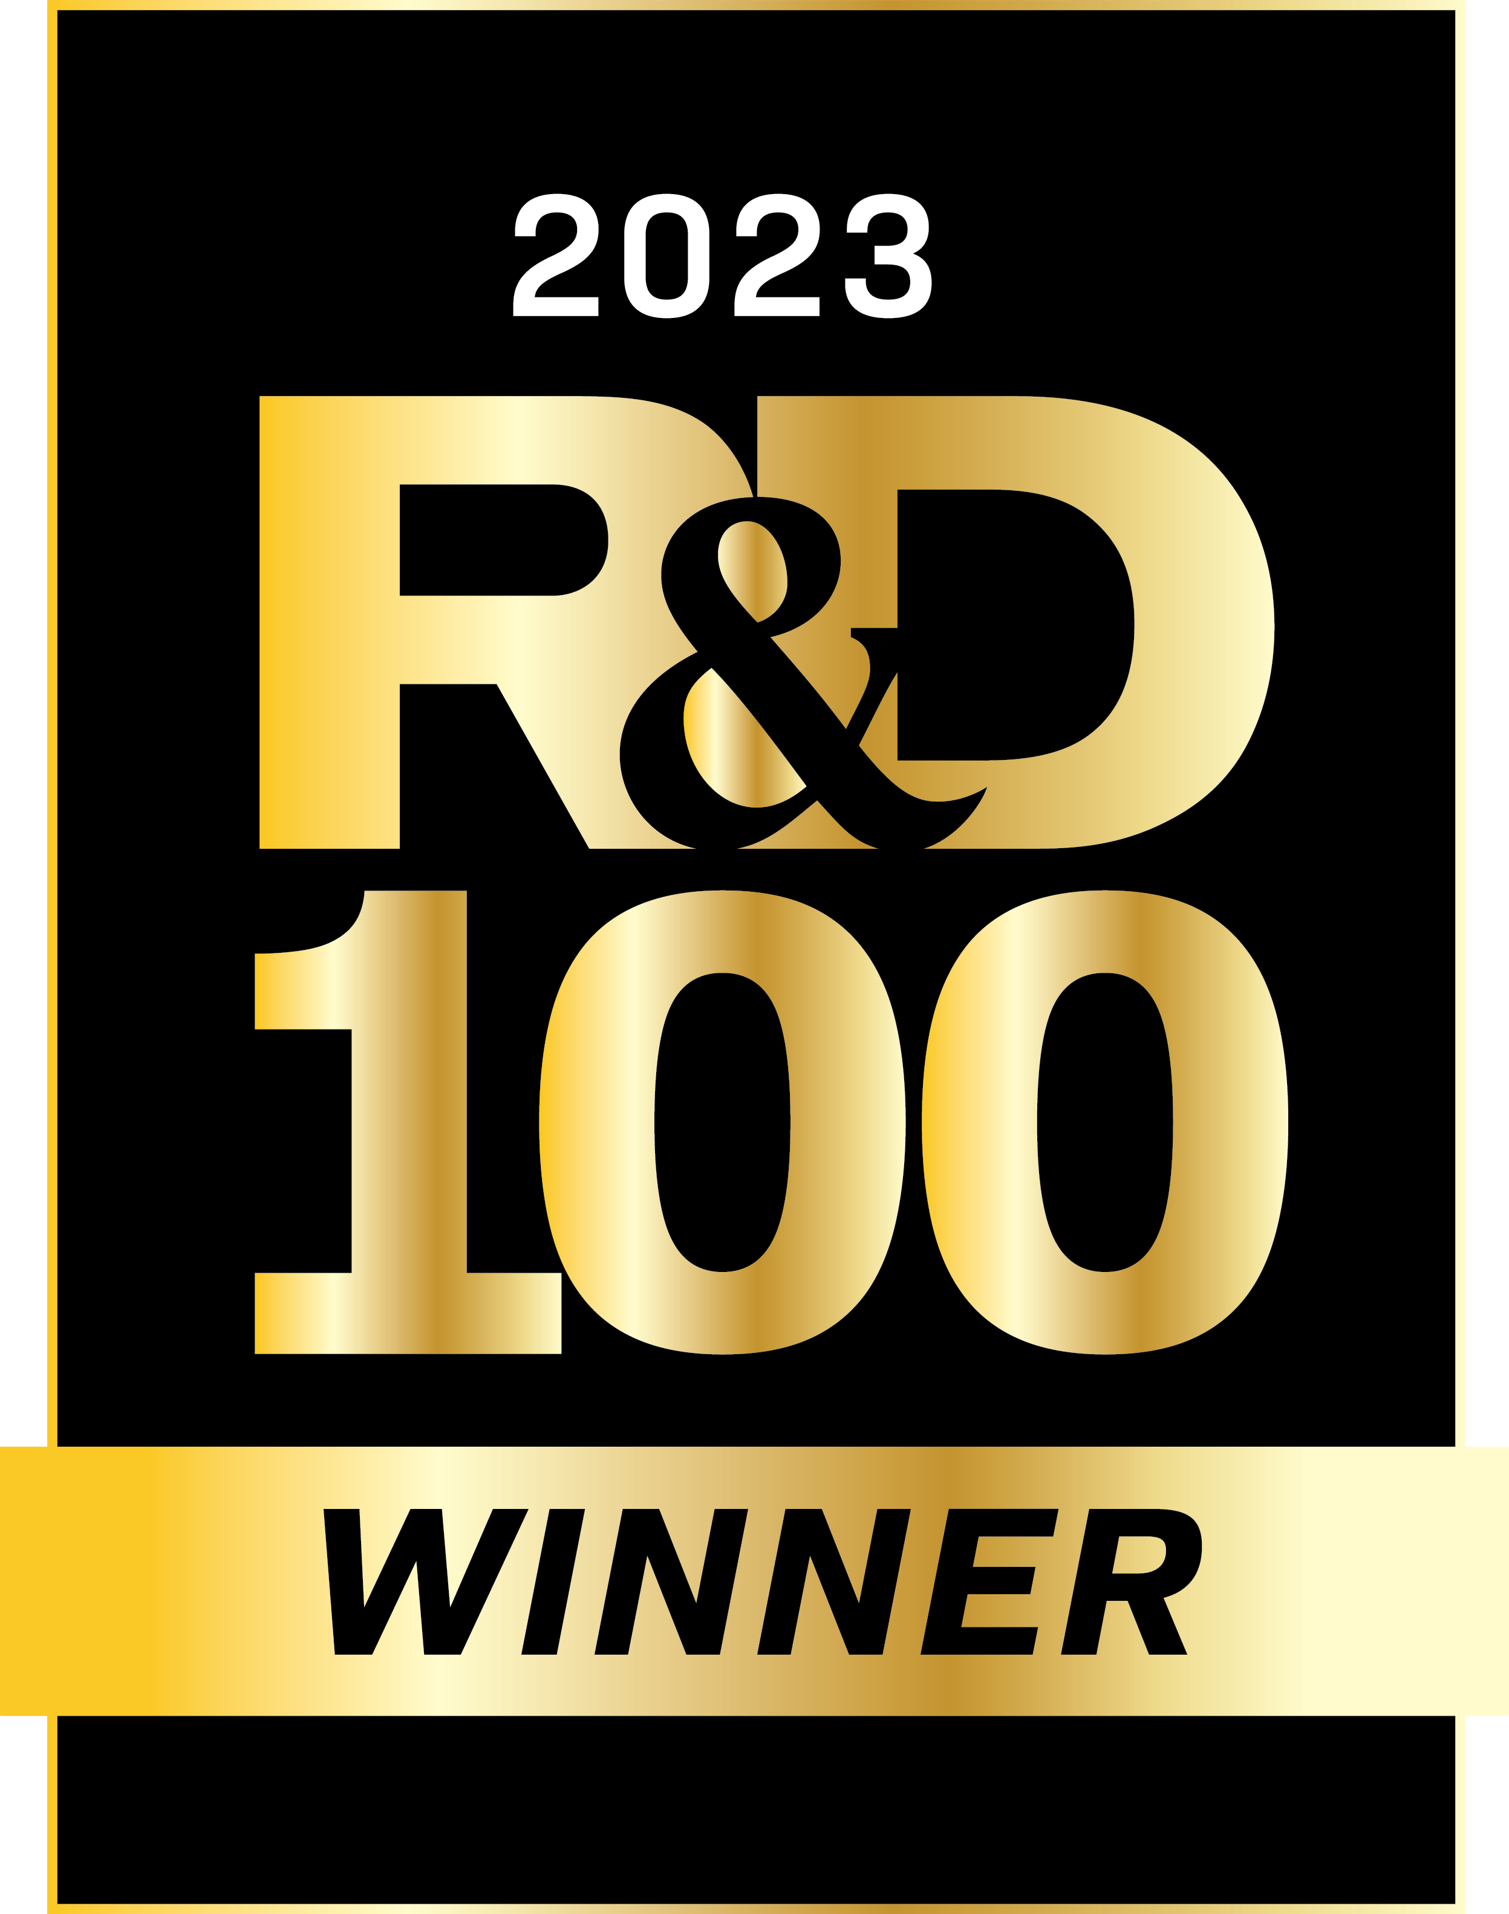
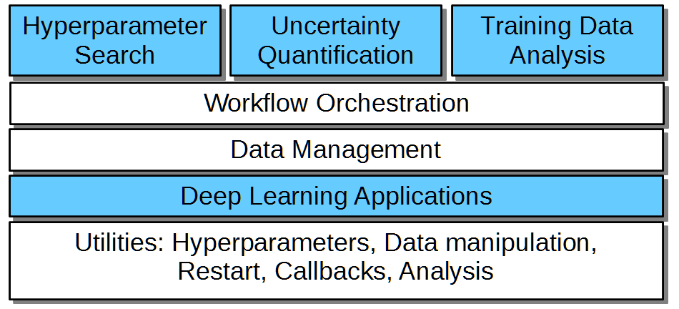
CANDLE/Supervisor overview
CANDLE/Supervisor consists of several high-level workflows:
Capable of modifying/controlling application parameters dynamically as the workflow progresses and training runs complete
Distribute work across large computing infrastructure, manage progress
Underlying applications are Python programs that use TensorFlow/PyTorch
“User code” shown in blue
“Utilities” shown in white
New studies would be developed by modifying the blue sections

Slide 6
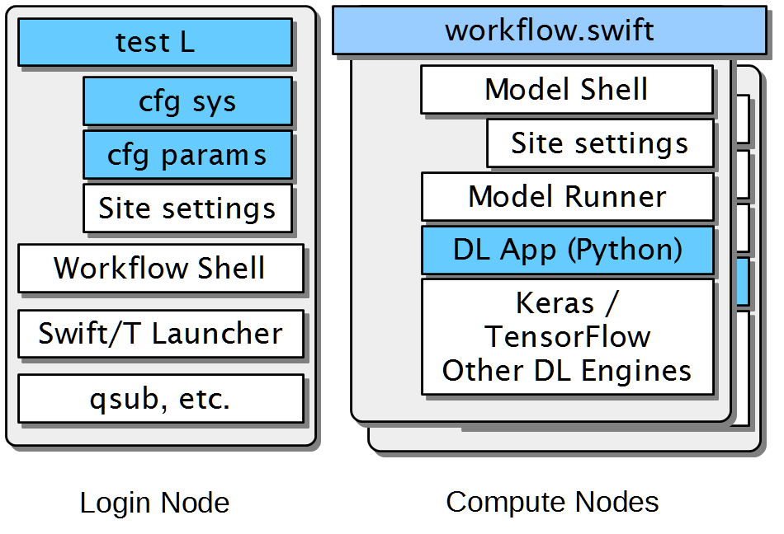
CANDLE/Supervisor Implementation
Runs start with a test script
CFG scripts contain settings for a system or parameters for a given study (e.g., search space)
Reusable site settings
The workflow shell script sets up the run
Swift/T launches and manages the workflow
Reusable Model scripts set up each app run
The DL app uses Keras/TF plus CANDLE Python utilities

Slide 7
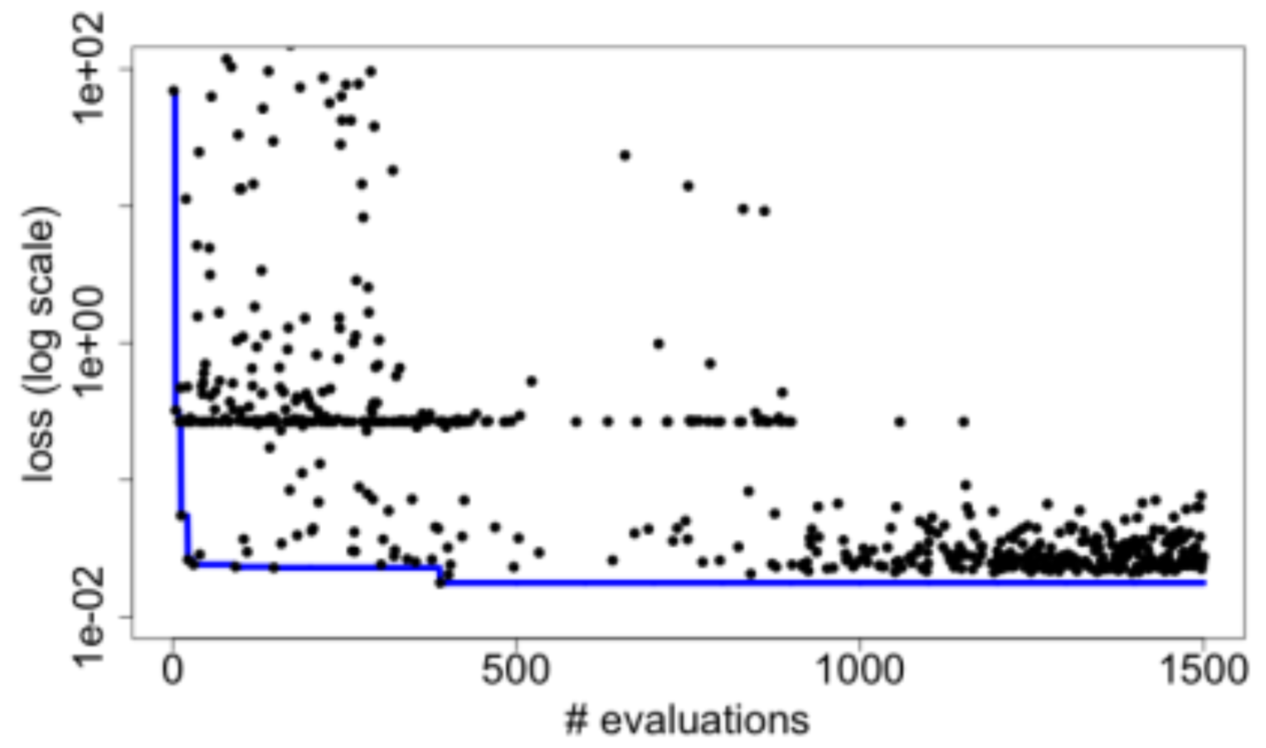
Example: Hyperparameter optimization
Search for the best combination of hyperparameters for a given DL app- neuron counts, functions, etc.
Optimize for validation loss, a measure of error
Use an external R library to perform the optimization
Iteratively receive trial hyperparameters, evaluate them with the obj() function, return results
Algorithm terminates after convergence or iteration limit
for (boolean b = true, int i = 1;
b; b=c, i = i + 1) {
string params = EQR_get(ME);
boolean c;
if (params == "DONE") {
string finals = EQR_get(ME);
c = false;
} else {
string param_array[] = split(params, ";");
string results[];
foreach param, j in param_array {
run_id = "%i_%i_%i" % (restart, i, j);
results[j] = obj(param, run_id);
}
string result = join(results, ";");
EQR_put(ME, result) => c = true;
}
}

Slide 8
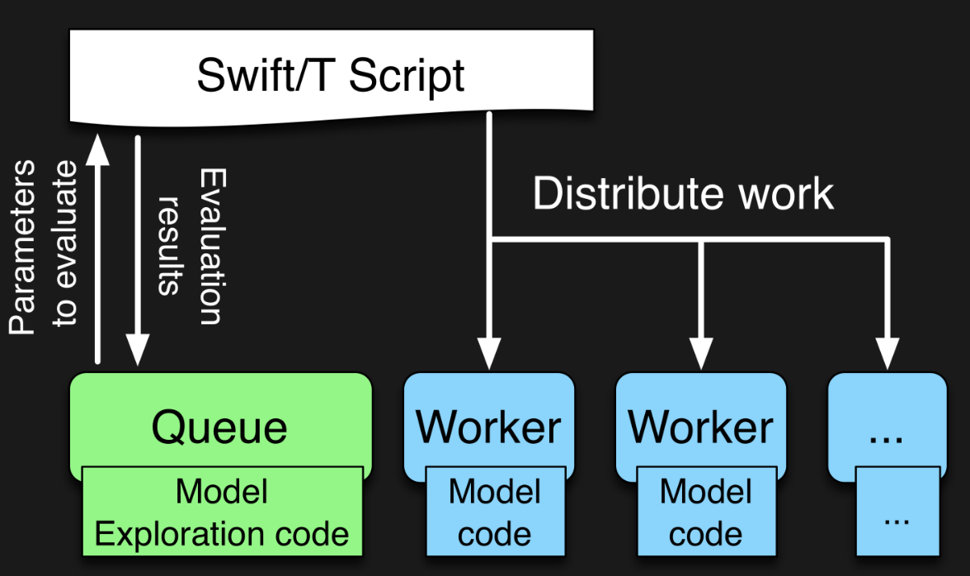
EMEWS workflow structure
The core novel contributions of EMEWS are shown in green, these allow the Swift script to access a running Model Exploration (ME) algorithm, and create an inversion of control (IoC) workflow
Both green and blue boxes accept existing, generic multi-language code- could be anything; we use optimization and deep learning modules
http://emews.org

Slide 9
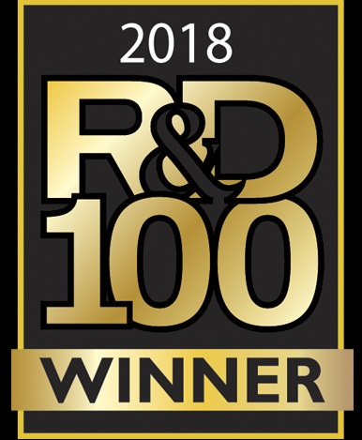
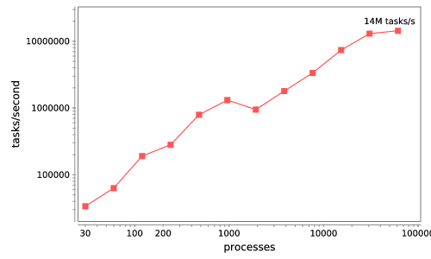
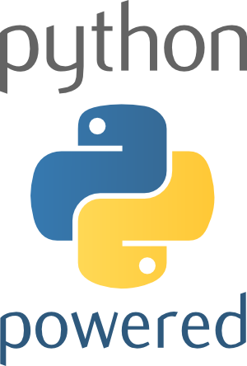
Swift/T: Enabling high-performance Scripted workflows
Supports tasks written in many languages
Write site-independent scripts, translates to MPI
Automatic task parallelization and data movement
Invoke native code, script fragments
Rapidly subdivide large partitions for MPI jobs in multiple ways
Swift/T control process
Swift/T worker
C
C++
Fortran
C
C++
Fortran
MPI
C
C++
Fortran
64K cores of Blue Waters
2 billion Python tasks 14 million Pythons/s
Swift/T: Scalable data flow programming for distributed-memory task-parallel applications Proc. CCGrid 2013.
$ spack install stc
$ conda install -c lightsource2-tag swift-t

Slide 10
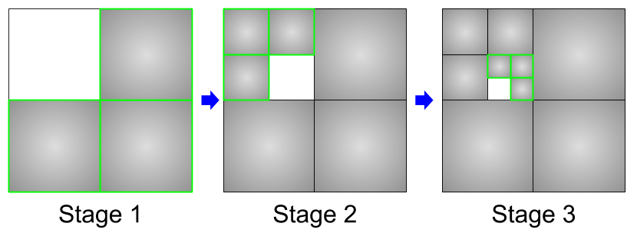
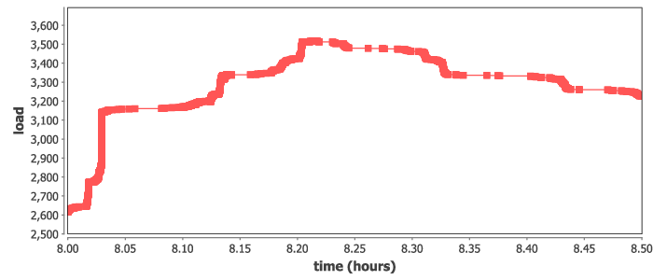
Example: INCREMENTAL learning
Split up the training data into subsets, iteratively train on most remaining subsets.
Weight sharing from one subset to the next (incremental learning)
Allows for investigations into data quality and learning patterns
Could also boost performance by preventing overloading data ingest limits
Recursive calls define the datasets for training
Runs at large scale on Summit, ramp-up/down
run_stage(int N, int S, string this, int stage,
void block, string plan_id) {
void parent = run_single(this, stage, block, plan_id);
if (stage < S) {
foreach id_child in [1:N] {
run_stage(N, S, this+"."+id_child, stage+1, parent,
plan_id, db_file, runtype);
}}
}
run_single(string node, int stage, void block) {
json_fragment = make_json_fragment(node, stage);
json = "{\"node\": \"%s\", %s}" % (node, json_fragment);
block => obj(json, node);
}

Slide 11
New problem: model comparison
Project IMPROVE: Gathering models from the greater community
Semi-automated framework for doing model comparisons, automating as much as possible
Prioritizing the following comparisons:
Cross-study generalization analysis
Data scaling and learning curves
Error analysis and subclass/subtyping
Robustness
Will be able to report the N top models using the framework that IMPROVE is curating for a given problem
Model recruitment: Ideally we are looking for:
Pan-cancer and multi-drug models
Features that we can easily compute → data curation
Predict continuous drug response in cell lines (AUC, IC50).
We are less interested in:
Drug-specific models (that don’t use drug features)
Models that use complex, application-specific feature representations
Notes:
Cross-study: …
Scaling: The response of the model as a function of the scale of training data. The learning curve work that plots Bias and Error curves as a function of scale of training data. The idea is to determine how data efficient each of the models are.
Error analysis: Drug MOA and Cancer type as start. The idea does the given model make the same types of errors as we have seen before.. that is the performance on easy vs hard combinations or is there some other behavior. This is part of working out the specific errors that each model makes and if those are correlated with anything in the model structure..
Robustness: …
I don’t think we are ready to spread folks out yet, we need the new folks to work side by side with our folks on the first two of these priorities before we split folks up too much.
We can define some folks to push on elements, but one hackathon does not an integrated team make. We need to get folks working for the next few months on these share goals at a deeper level than what happened at the hackathon. We probably also need to crank a dozen or so models through the whole system. → should we discuss future hackathons?

Slide 12
Curation status
Status of the model curation effort
Have 28 models that have been successfully run by the computer science team
9 fully tagged in release for September, 2023
Models by engine: TF1=8, TF2=1, PyTorch=19
Deep learning approach: CNN=12, Attention=4, Transformer=3
CANDLE-compliant: 10
The IMPROVE Framework
Each model is packaged in a Singularity container, with a common shell script interface:
preprocess.sh → Data preprocessing transforms raw DRP data into ML data
train.sh → Model Training uses ML data to train the model and saves the model
infer.sh → Use the trained model and ML data to run inference saves raw predictions
Collaboration idea
What else can we do with a large collection of ML models built for similar problems?

Slide 13
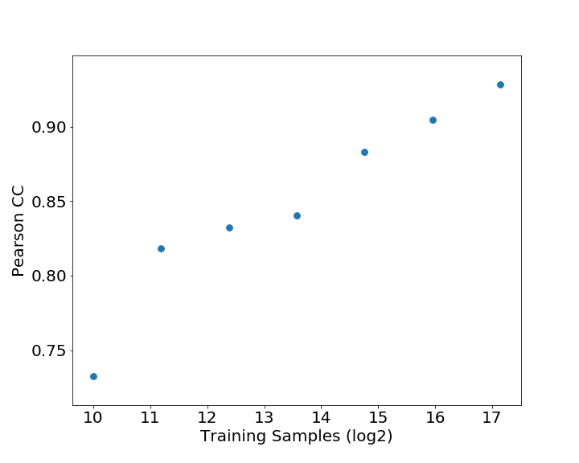
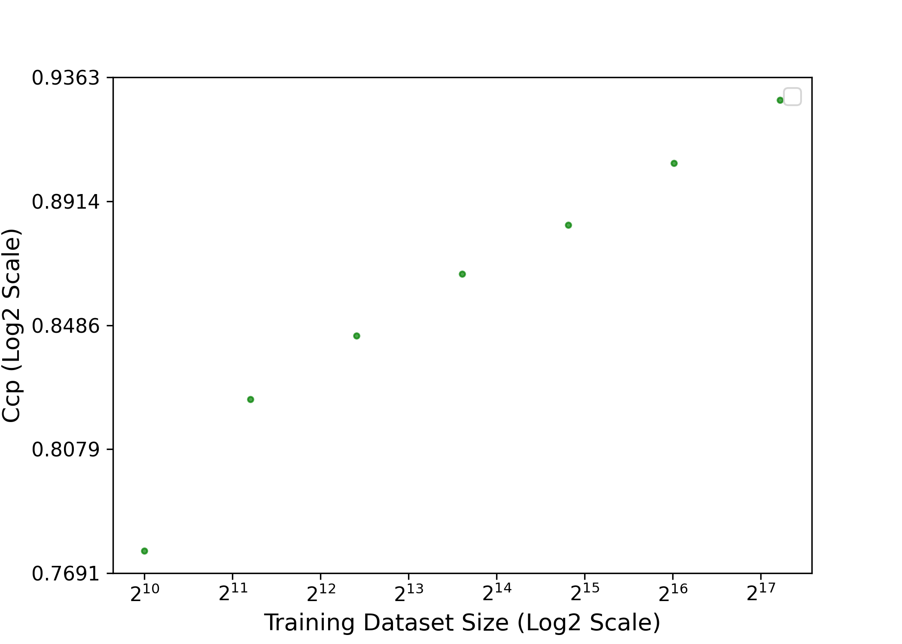
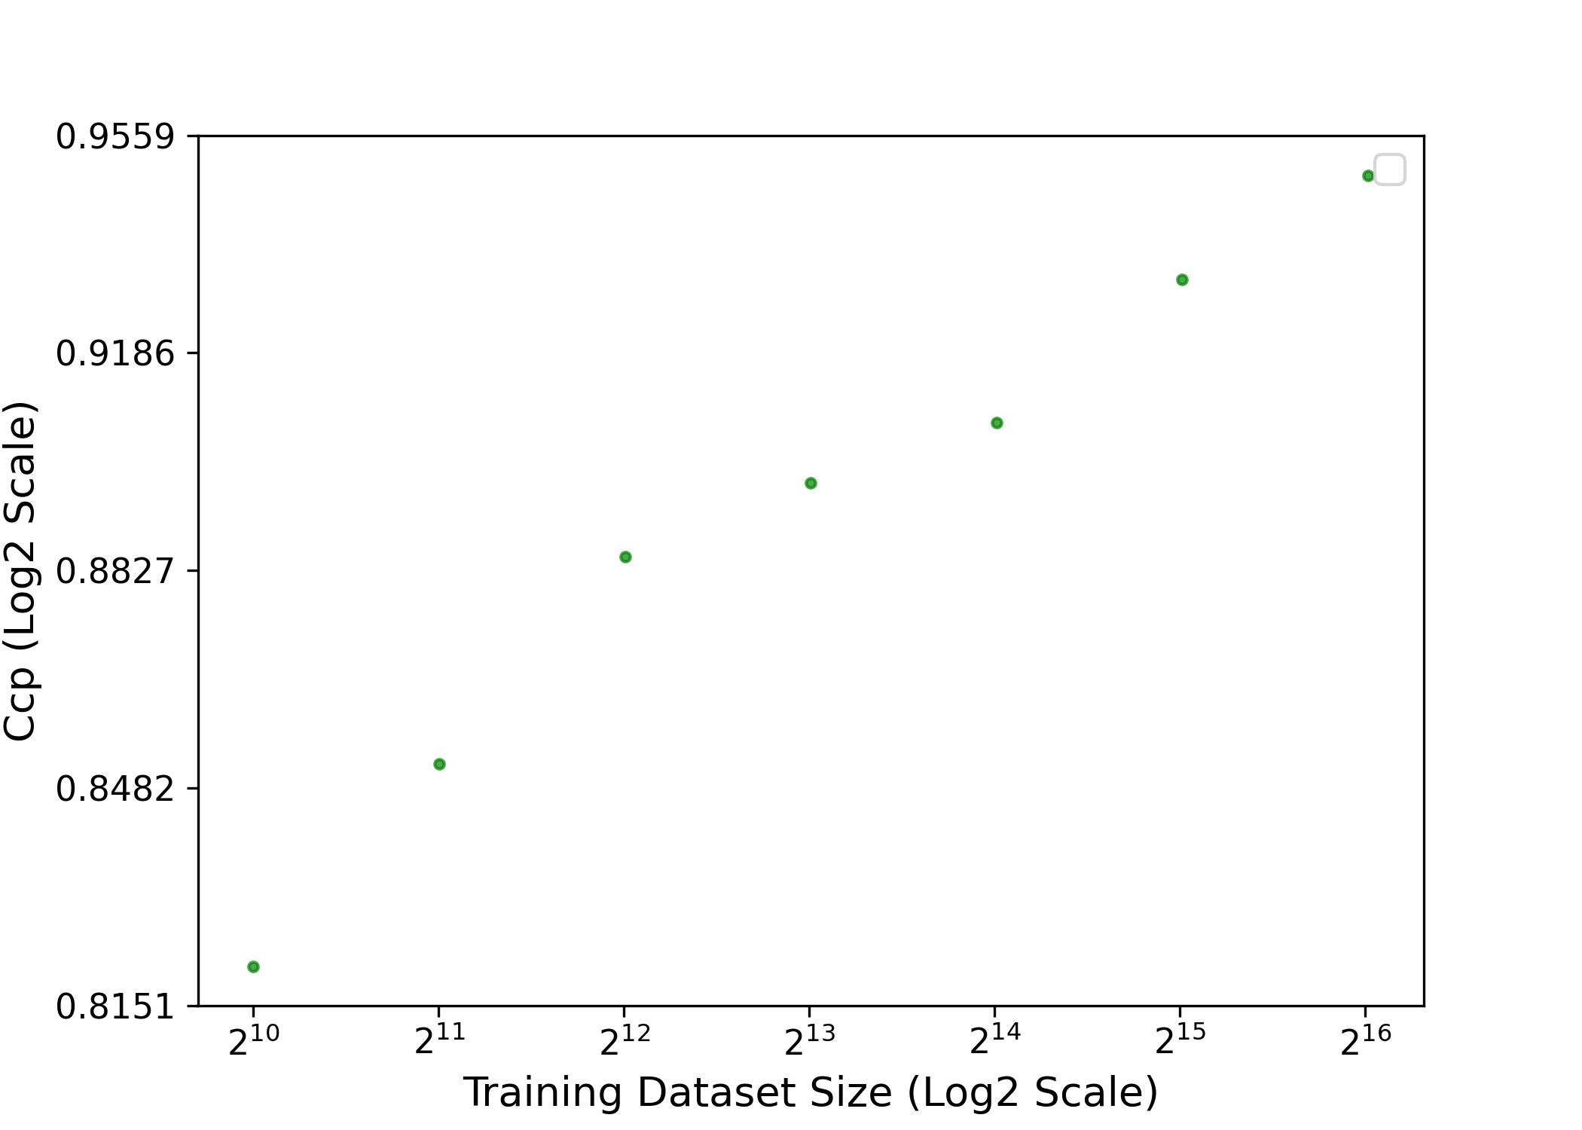
Learning Curve comparison
Three different models for tumor response to various drugs
HiDRA
GraphDRP
TGSA
Response:
GDSC1
Tumors:
Gene expression of ~4,700 genes based on KEGG pathways
Drugs:
SMILES
Response:
GDSC1
Tumors:
CNV, mutations (downloaded from cancergene.org)
Drugs:
Drugs represented in graphs
Response:
GDSC2
Tumors:
Gene expression, mutation, and CNV (706 gene-related genes were selected based on COSMIC)
PPI of the 706 genes encoded in graph structures
Drugs:
Drugs represented in graphs
Notes:
03-28-2022

Slide 14
New Comparison workflow: “CMP”
Starting with simple sweep over model behavior
Initial problem:
Want to perform cross-model comparison for two models
Want to specify range of hyperparameter values for comparison
Need to compare across cross-validation of underlying data
Want to compare error values at coarse-grained level
Approach:
Recast model comparison run as a new CANDLE-compliant “model”
Accepts two real CANDLE-compliant models
Trains and reports differences in errors
Can run flat sweep problem above
Near-future work
Flat sweep above produces hundreds to thousands of training runs
For larger problems (more hyperparameter comparisons), will need to apply CANDLE parameter exploration workflow
Cancer/drug type
Memory constraint
M1 better
Models agree
M2 better
Conceptual example

Slide 15
MODEL CONFIGURATIONS
1) Data sources- varying studies and experiment types. Different laboratory studies could have subtle differences in data collection.
2) Data representation- varying data formats. For example, a drug could be represented as a SMILES string or a series of features.
3) Algorithms and architectures- varying models could have very different algorithmic structure or DL architectures. While inputs and outputs may be comparable, interpreting variations could be very difficult.
The search space can be very large and high-dimensional
Could envision searching for configuration regions that agree, disagree, etc.
Could help with model selection (mixture of experts)
Could help with model debugging or hyperparameterization
Could help with cross-study analysis (our case studies)
In this presentation, we cover running Uno against 2 different data sets

Slide 16
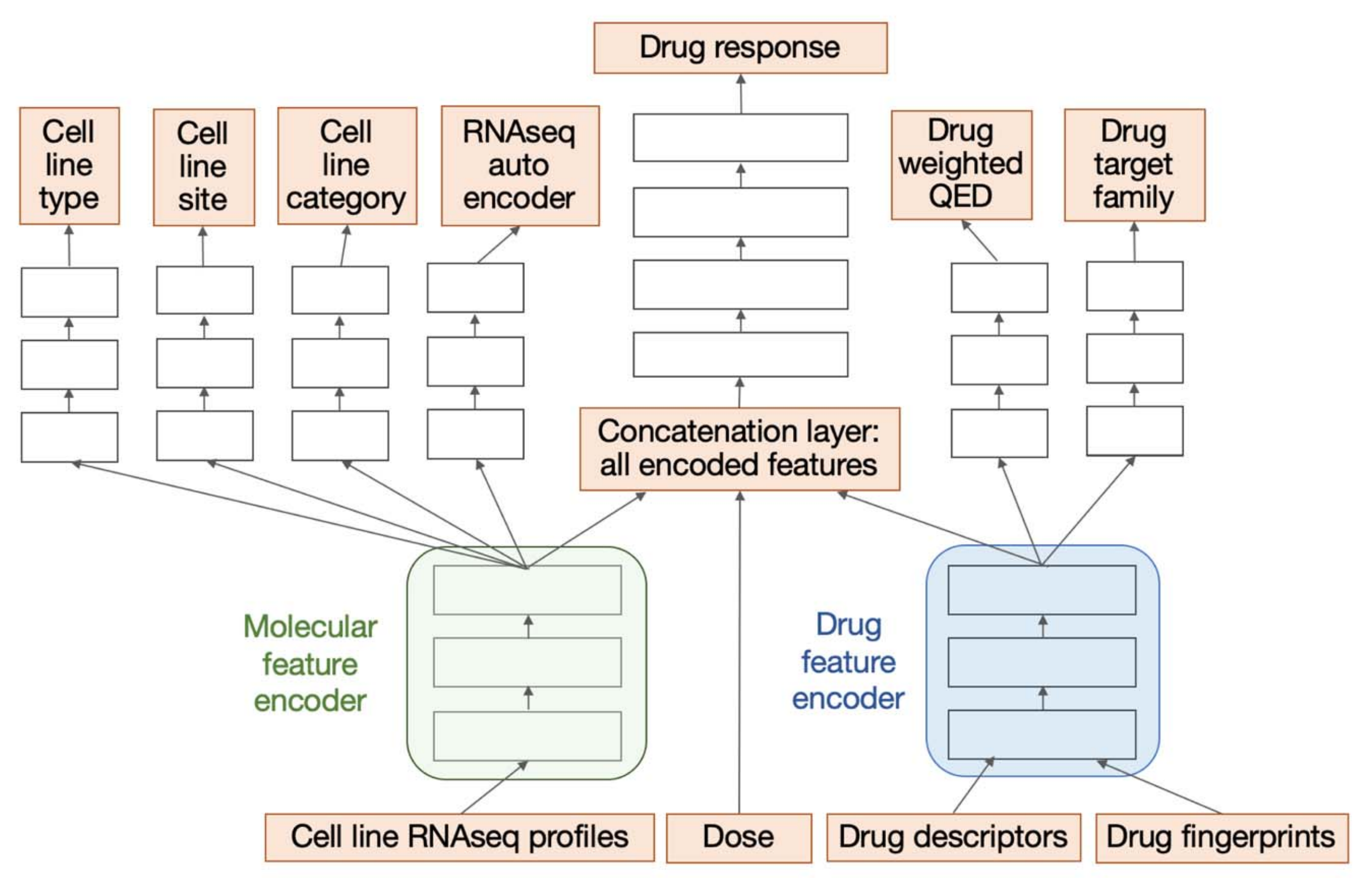
The uno model
A drug response predictor
The Uno model trains on multiple drugs and a given cell line to fit against the observed growth response (AUC). Has rich capability for re-configuration via hyperparameters.
Xia et al. A cross-study analysis of drug response prediction in cancer cell lines. Briefings Bioinform. 23(1), 2022.

Slide 17
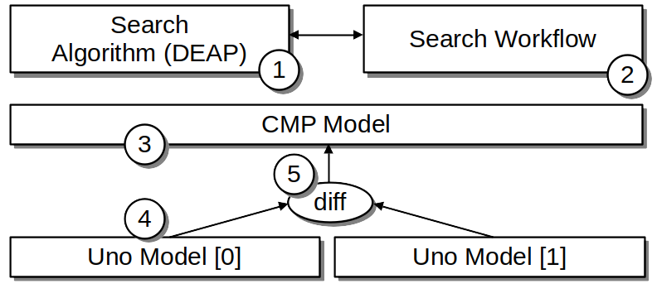
The Comparator MODEL
Runs two models, returns a difference
The search algorithm, Distributed Evolutionary Algorithms in Python
The search workflow, the Supervisor GA workflow
The Comparator model
Two Uno models parameterized differently
A differencing function in Python – relative error
Launches the 2 models sequentially via subprocess.run()

Slide 18
CANDLE Hyperparameters
Extends notion of machine learning hyperparameters
CANDLE has a notion of “compliance” which is a set of Python functions and hyperparameters that models must respect
Uno
dense=[1000, 1000, 1000]
dense_feature_layers=[1000, 1000, 1000]
optimizer='adam'
scaling='std'
Comparator hyperparameters
noise, layer_force ← Assigned by the workflow
cmp_0_train_sources = 'CCLE'
cmp_1_train_sources = 'gCSI'
cmp_0_run_id = 'M0'
cmp_1_run_id = 'M1'
Checkpointing, etc.
Noise: See: Jain et al. Probing decision boundaries in cancer data using noise injection and counterfactual analysis. Computational Approaches for Cancer Workshop @ SC 2021.
dropout=0
epochs=10
batch_size=32

Slide 19
DEAP: Evolutionary algorithm
Easy-to-run Python library
Available from: https://github.com/DEAP
We set DEAP up for a 2 variable run:
DEAP hyperparameters could probably have been reduced for larger runs
Does mutation and cross-over offspring generation according to specifications in workflow
Wired up to the workflow via EMEWS
[ { "name": "noise",
"type": "float",
"lower": 0.0,
"upper": 55
},
{ "name": "layer_force",
"type": "int",
"lower": 500,
"upper": 1000
} ]

Slide 20
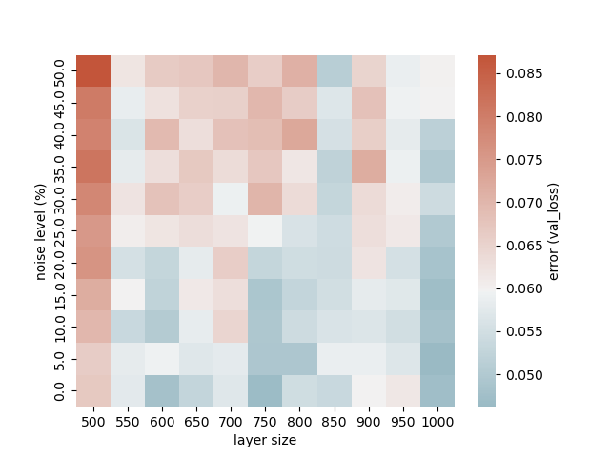
Uno model baseline performance
Uno model performance with CCLE.
Uno model performance with gCSI.
Red is higher error (worse).
We ran the grid search on ALCF Polaris 1 model per GPU, ~10s/epoch on the NVIDIA A100, 10 epochs.

Slide 21
Uno model differencing
Results of grid search over the Comparator model
Difference in val_loss for Uno(gCSI) vs. Uno(CCLE) Higher differences trend in the direction of more noise and larger layer sizes

Slide 22
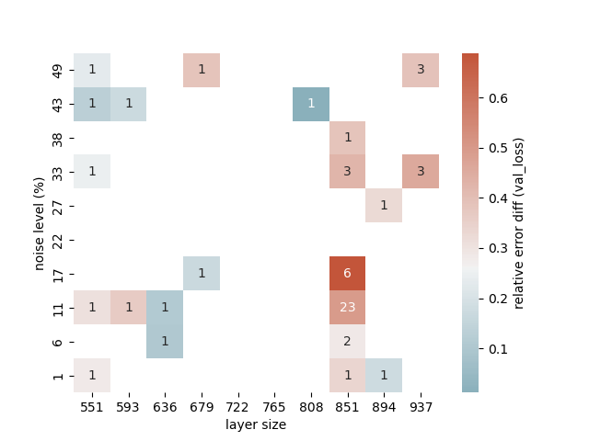
Benefits of automated search
DEAP quickly identifies the best regions and focuses search there
Heat map shows the best value in that cell and the number of samples evaluated in that cell.
Automated searches were run on CELS Lambda, ~20s/epoch on the NVIDIA V100, 10 epochs.

Slide 23
Population performance vs. grid search
Grid search: 100 samples DEAP: 16 samples/generation After 2 generations of DEAP, its smaller population has a better data point than grid search, and after 4 generations the entire population is better

Slide 24
summary
Reusing infrastructure for new problems
There is a growing community of model builders for cancer problems, especially drug response prediction
Need an efficient way to identify differences across models and datasets
We recast model comparison as an optimization problem and reused the techniques we have developed for hyperparameter optimization
Demonstrated the generality of the CANDLE conventions
Could scale with prior CANDLE runs (1000s of GPUs)

Slide 25
Ongoing and Future work
The IMPROVE project will be performing additional HPO runs on all of the models in our September 2023 release
We will then be looking at model comparison and cross-study analysis
Future work could include integration with a more advanced algorithm beyond DEAP, something that can probe multiple models, the datasets, etc.
Will want a more restartable, campaign-oriented workflow suite
Looking for collaborative ideas for the IMPROVE models

Slide 26
QUESTIONS?

Slide 27
Thanks
Thanks to the organizers
Code and guides:
CANDLE GitHub: https://github.com/ECP-CANDLE
Swift/T Home: http://swift-lang.org/Swift-T
EMEWS Tutorial: http://emews.org
This research was supported by the Exascale Computing Project (17-SC-20-SC), a joint project of the U.S. Department of Energy’s Office of Science and National Nuclear Security Administration, responsible for delivering a capable exascale ecosystem, including software, applications, and hardware technology, to support the nation’s exascale computing imperative.

Slide 28
This manuscript was created by UChicago Argonne, LLC, Operator of
Argonne National Laboratory (``Argonne''). Argonne, a U.S. Department
of Energy Office of Science laboratory, is operated under Contract
DE-AC02-06CH11357. The U.S. Government retains for itself, and others
acting on its behalf, a paid-up nonexclusive, irrevocable worldwide
license in said article to reproduce, prepare derivative works,
distribute copies to the public, and perform publicly and display
publicly, by or on behalf of the Government.

