Slide 1
Big Data Tools for Light Source Science
Justin M Wozniak <wozniak@mcs.anl.gov>
Ray Osborn, Stephan Rosencranz, Matthew Krogstad,
Guy Jennings, Kyle Chard, Ben Blaiszik,
Michael Wilde, Ian Foster

Slide 2
TALK overview
Goals – Tools – Case Studies

Slide 3
Goals
Automated data capture and analysis pipelines
To boost productivity during beamtime
Integration with high-performance computers
To integrate experiment and simulation
Effective use of large data sets
Maximize utility of high-resolution, high-frame-rate detectors and automation
High interactivity and programmability
Improve the overall scientific process

Slide 4
Tools
Swift
Workflow language with very high scalability
Globus Catalog
Annotation system for distributed data
Globus Transfer
Parallel data movement system
NeXpy/NXFS
GUI with connectivity to Catalog and Python remote object services

Slide 5
Case studies
ANL Overview
MCS, ALCF, and APS
Diffuse scattering pipeline
ANL/APS-based workflow
CCTW: Crystal Coordinate Transformation Workflow
Parallelizable, fast coordinate transform code
DIFFEV – Discus-based evolutionary algorithm
Parallelizable HPC experiment fitting
Sharma workflow for NF-HEDM
Big data / HPC exemplar
CHESS!

Slide 6
SwifT
High performance workflows

Slide 7
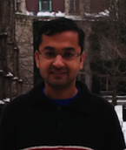
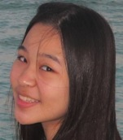
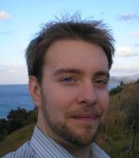
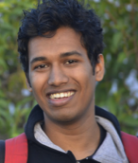
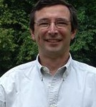
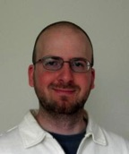
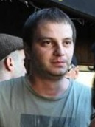
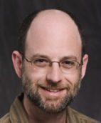
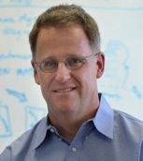

The Scientific Computing Campaign
Swift addresses most of these components
THINK about what to run next
RUN a battery
of tasks
IMPROVE methods and codes
COLLECT results

Slide 8
Goals of the Swift language
Swift was designed to handle many aspects of the computing campaign
Ability to integrate many application components into a new workflow application
Data structures for complex data organization
Portability- separate site-specific configuration from application logic
Logging, provenance, and
plotting features
Today, we will focus on running scripted
application components at large scale
THINK
RUN
IMPROVE
COLLECT

Slide 9

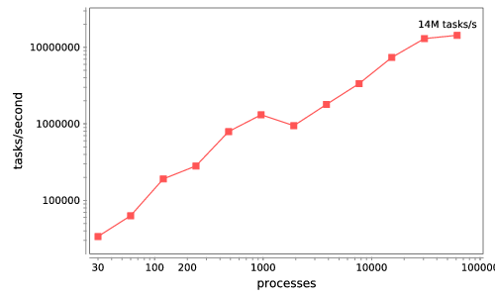




Swift/T: Enabling high-performance workflows
Write site-independent scripts
Automatic parallelization and data movement
Run native code, script fragments as applications
Rapidly subdivide large partitions for
MPI jobs
Move work to data locations
Swift/T worker
Swift/T control process
Swift worker process
Swift control process
Swift control process
C
C++
Fortran
C
C++
Fortran
C
C++
Fortran
MPI
64K cores of Blue Waters
2 billion Python tasks
14 million Pythons/s

Slide 10
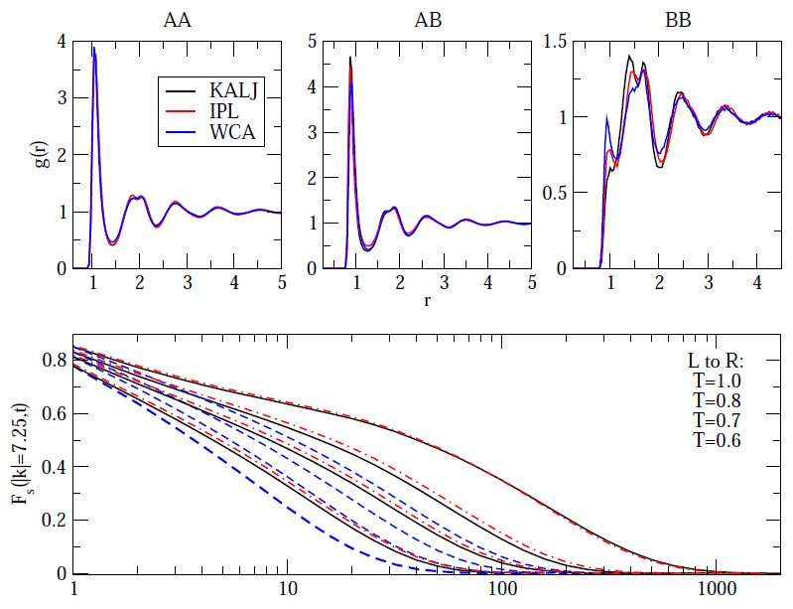
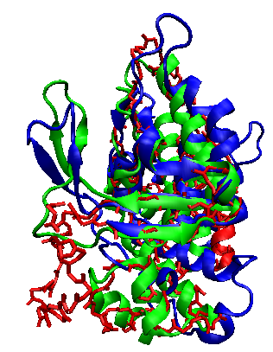
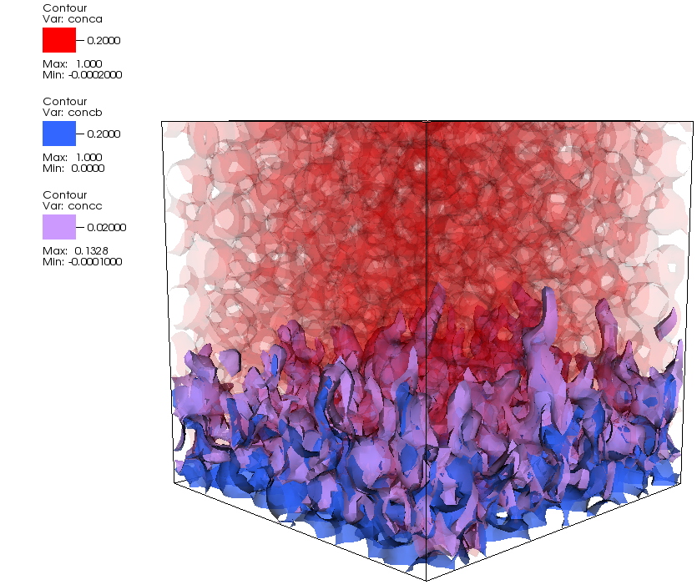
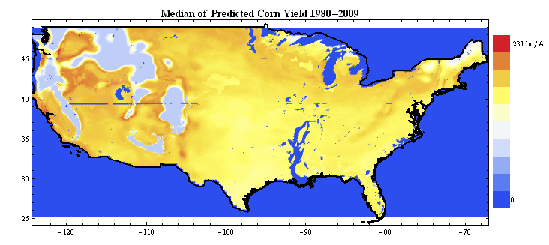
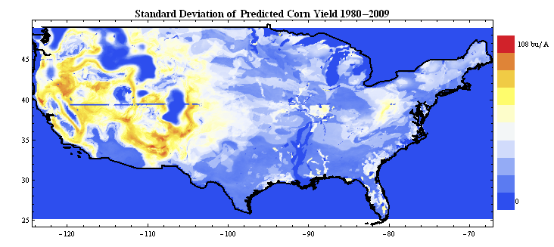
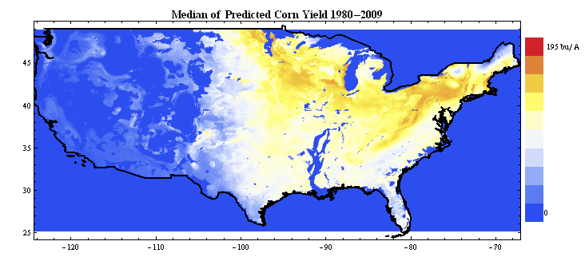
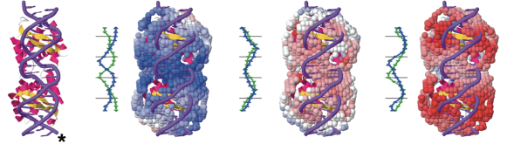
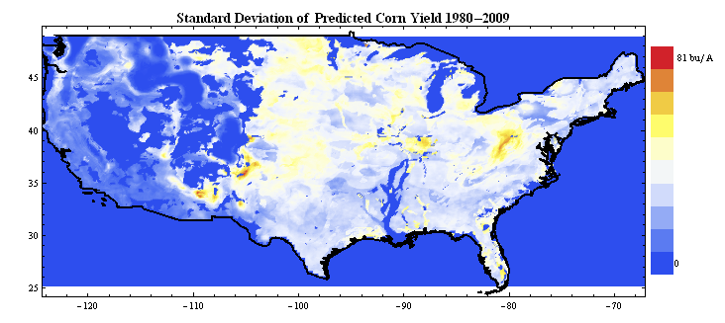
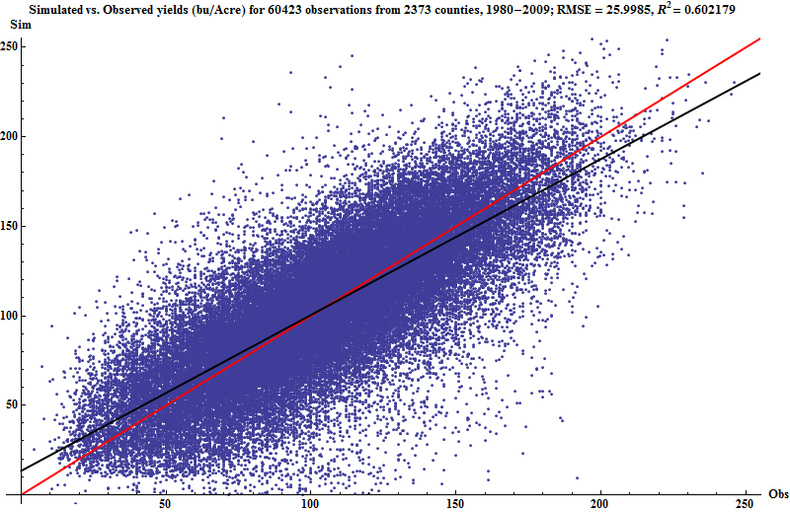
Large-scale many-task applications using Swift
T0623, 25 res., 8.2Å to 6.3Å (excluding tail)
Simulation of super-
cooled glass materials
Protein folding using homology-free approaches
Climate model analysis and decision making in energy policy
Simulation of RNA-protein interaction
Multiscale subsurface
flow modeling
Modeling of power grid
for OE applications
All have published science results obtained using Swift
A
B
C
A
B
Initial
Predicted
Native
D
E
F
F
E
>
Protein loop modeling. Courtesy A. Adhikari
D
C

Slide 11
Swift programming model: all progress driven by concurrent dataflow
(int r) myproc (int i, int j)
{
int f = F(i);
int g = G(j);
r = f + g;
}
F() and G() implemented in native code
F() and G()run in concurrently in different processes
r is computed when they are both done
This parallelism is automatic
Works recursively throughout the program’s call graph

Slide 12
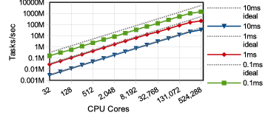
Basic scalability
Up to 1.5 billion tasks/second on 512K cores of Blue Waters, so far

Slide 13
Swift programming model
Data types
int i = 4;
int A[];
string s = "hello world";
Mapped data types
file image<"snapshot.jpg">;
Structured data
image A[]<array_mapper…>;
type protein {
file pdb;
file docking_pocket;
}
protein p<ext; exec=protein.map>;
Conventional expressions
if (x == 3) {
y = x+2;
s = strcat("y: ", y);
}
Parallel loops
foreach f,i in A {
B[i] = convert(A[i]);
}
Data flow
merge(analyze(B[0], B[1]),
analyze(B[2], B[3]));
Swift: A language for distributed parallel scripting, J. Parallel Computing, 2011

Slide 14
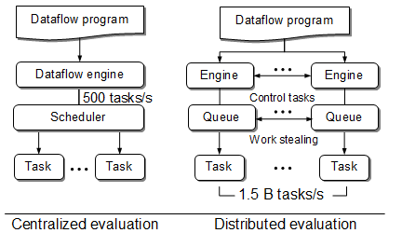
Swift/T: Distributed dataflow processing
Had this:
(Swift/K)
For extreme scale, we need this:
(Swift/T)
Wozniak et al. Swift/T: Scalable data flow programming for distributed-memory task-parallel applications . Proc. CCGrid, 2013.

Slide 15
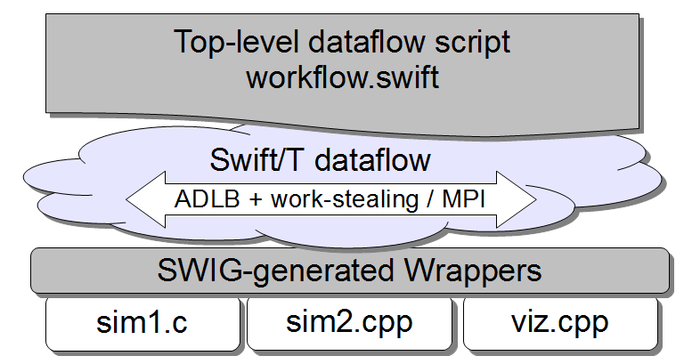
Dataflow script produces work for work queue
Including MPI libraries, GPU tasks, …

Slide 16
Characteristics of very large Swift programs
int X = 100, Y = 100;
int A[][];
int B[];
foreach x in [0:X-1] {
foreach y in [0:Y-1] {
if (check(x, y)) {
A[x][y] = g(f(x), f(y));
} else {
A[x][y] = 0;
}
}
B[x] = sum(A[x]);
}
The goal is to support billion-way concurrency: O(10⁹)
Swift script logic will control trillions of variables and data dependent tasks
Need to distribute Swift logic processing over the HPC compute system

Slide 17
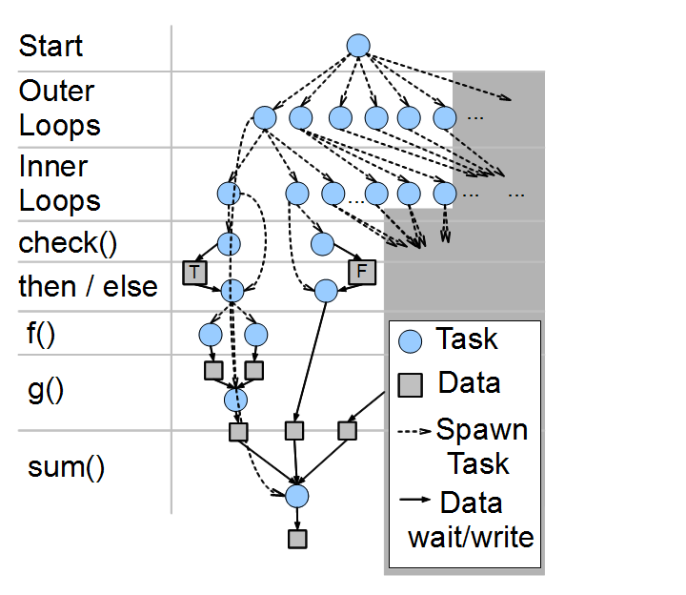
Swift/T: Fully parallel evaluation of complex scripts
int X = 100, Y = 100;
int A[][];
int B[];
foreach x in [0:X-1] {
foreach y in [0:Y-1] {
if (check(x, y)) {
A[x][y] = g(f(x), f(y));
} else {
A[x][y] = 0;
}
}
B[x] = sum(A[x]);
}

Slide 18
Notification-driven execution
A[2] = f(getenv(“N”));
Code
Engines: evaluate dataflow primitives
Workers: execute tasks
A[3] = g(A[2]);
Perform getenv()
Submit f
Subscribe to A[2]
Submit g
Task put
Task put
Notification
Process f
Store A[2]
Process g
Store A[3]
Wozniak et al. Turbine: A distributed-memory dataflow engine for high performance many-task applications. Fundamenta Informaticae 128(3), 2013.

Slide 19
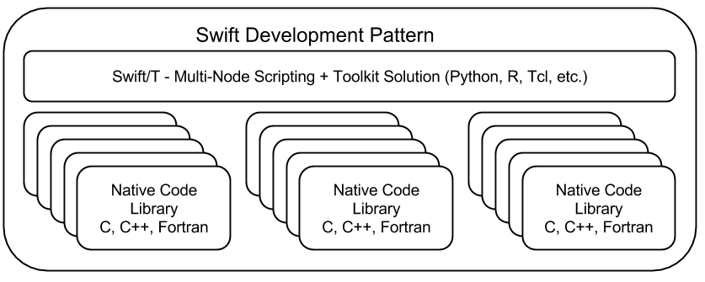
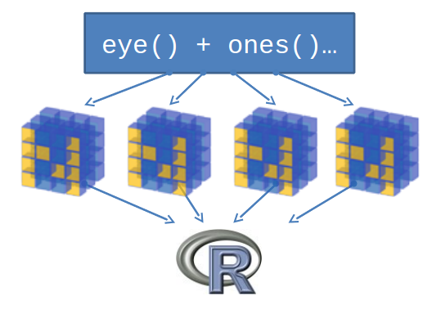
Support calls to embedded interpreters
Wozniak et al. Mega Python: Scalable interlanguage scripting for scientific computing. MCS Tech Report ANL/MCS-P5020-0913.

Slide 20
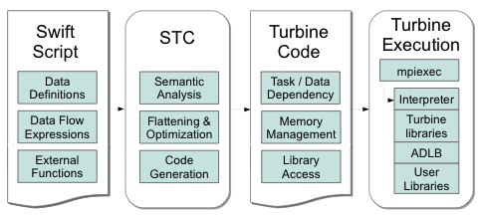
STC: The Swift-Turbine Compiler
STC translates high-level Swift
expressions into low-level
Turbine operations:
  Create/Store/Retrieve typed data
  Manage arrays
  Manage data-dependent tasks
Armstrong et al. Compiler techniques for massively scalable implicit task parallelism.
Under review for: SC 2014.
Wozniak et al. Large-scale application composition via distributed-memory
data flow processing. Proc. CCGrid 2013.

Slide 21
Features for Big Data analysis
Location-aware scheduling
User and runtime coordinate data/task locations
Collective I/O
User and runtime coordinate data/task locations
Application
I/O hook
Application
Dataflow,
annotations
Runtime
MPI-IO transfers
Runtime
Hard/soft locations
Distributed data
Distributed data
Parallel FS
F. Duro et al. Exploiting data locality in Swift/T workflows using Hercules.
Proc. NESUS Workshop, 2014.
Wozniak et al. Big data staging with MPI-IO for interactive X-ray science.
Proc. Big Data Computing, 2014.

Slide 22
Globus catalog
Annotation system for distributed scientific data

Slide 23
Catalog Goals
Group data based on use, not location
  Logical grouping to organize, reorganize, search, and describe usage
Annotate with characteristics that reflect content …
  Capture as much existing information as possible
  Share datasets for collaboration- user access control
Operate on datasets as units
Research data lifecycle is continuous and iterative:
  Metadata is created (automatically and manually) throughout
  Data provenance and linkage between raw and derived data
Most often:
  Data is grouped and acted on collectively
    Views (slices) may change depending on activity
  Data and metadata changes over time
  Access permissions are important (and also change)

Slide 24
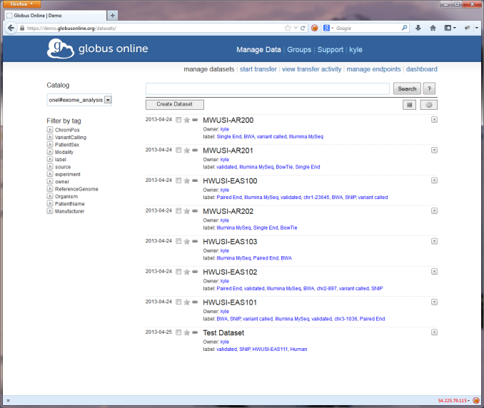
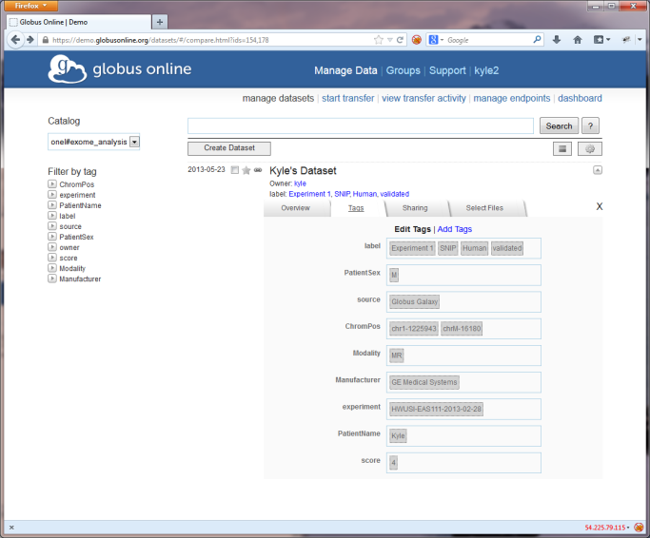
Catalog Data Model
Catalog: a hosted resource that enables the grouping of related datasets
Dataset: a virtual collection of (schema-less) metadata and distributed data elements
Annotation: a piece of metadata that exists within the context of a dataset or data member
  Specified as key-value pairs
Member: a specific data item (file, directory) associated with a dataset

Slide 25
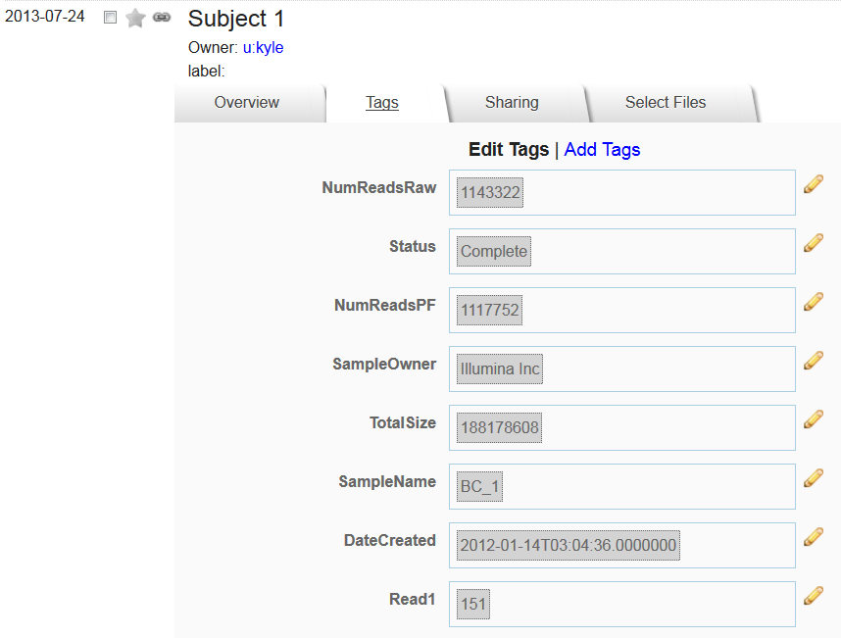
Web interface for annotations

Slide 26
Globus transfer
High-speed wide area data transfers

Slide 27





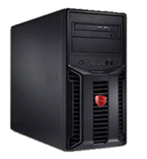

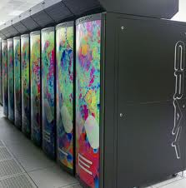
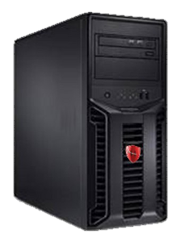
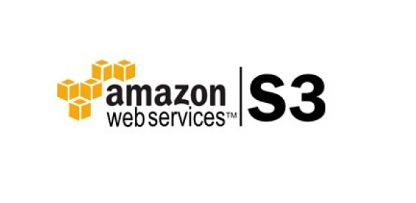
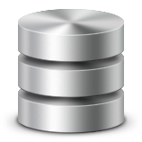
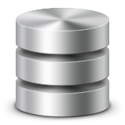
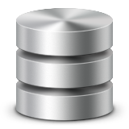












Globus Transfer
Supercomputers and Campus Clusters
Personal Resources
Object Storage
Block/Drive Storage
Instance Storage
Globus Connect
Globus Connect
Globus Connect
Globus Connect
Globus Endpoints
Globus Nexus
InCommon/CILogon
Transfer
Synchronize
OpenID
Share
MyProxy OAuth

Slide 28


Globus Transfer
Reliable, secure, high-performance file transfer and synchronization
“Fire-and-forget” transfers
Automatic fault recovery
Seamless security integration
10x faster than SCP
2
Globus moves and syncs files
Data
Source
Data
Destination
1
User initiates transfer request
3
Globus notifies user

Slide 29
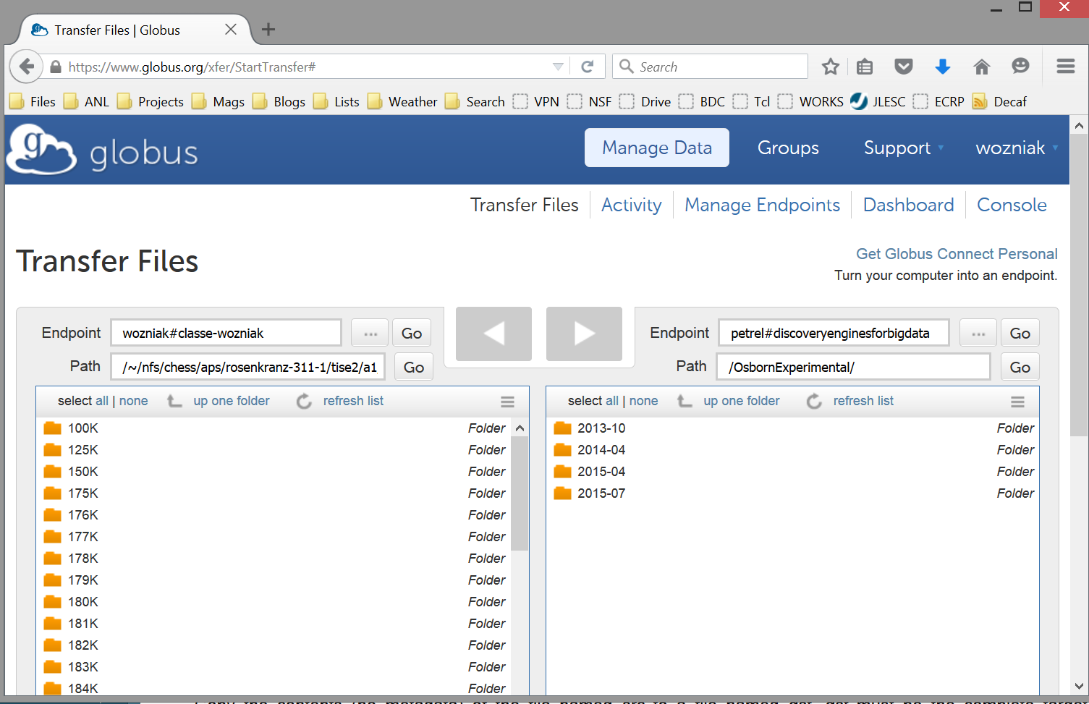
Globus Transfer: CHESS to ALCF

Slide 30

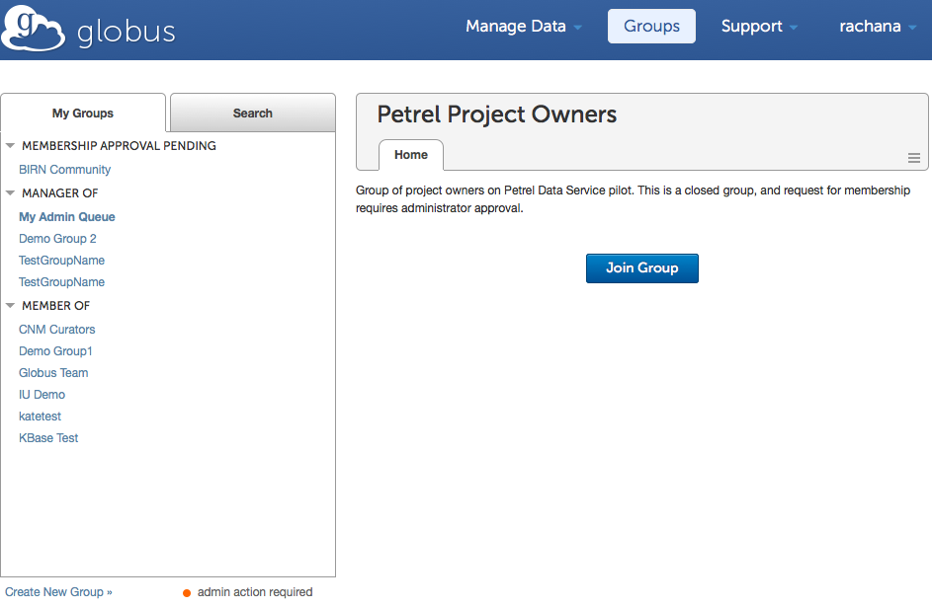
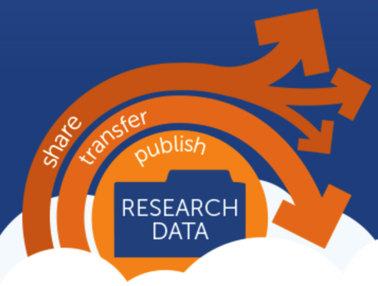
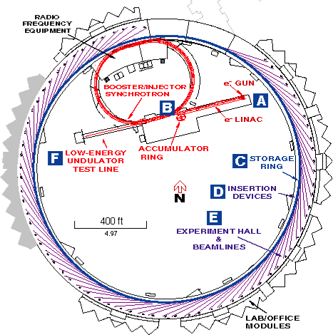
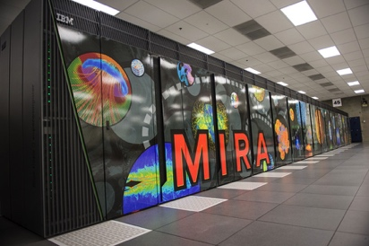
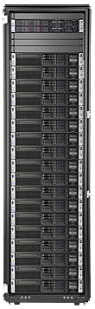
The Petrel research data service
High-speed, high-capacity data store
Seamless integration with data fabric
Project-focused, self-managed
globus.org
100 TB allocations
User managed access
Other sites, facilities, colleagues
3 GB/s network
32 I/O nodes with GridFTP
1.7 PB GPFS store
Notes:
A uniform data fabric across the lab
… with seamless access to large data…
… for use in computation, collaboration and distribution …
… that is project focused and self managed …
… and is described and discoverable

Slide 31
Aps overview
Argonne National Laboratory – Advanced Photon Source

Slide 32
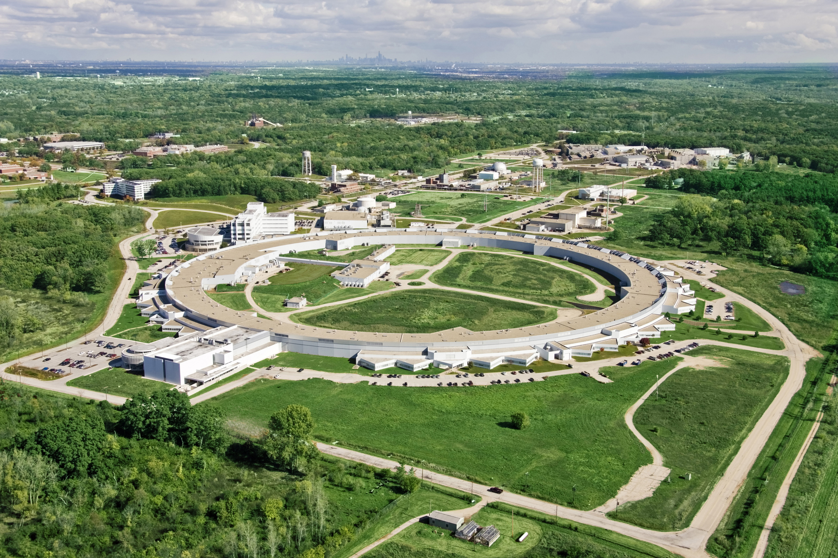
Chicago
Supercomputers
Advanced Photon Source (APS)

Slide 33
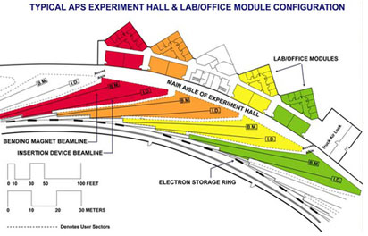
Advanced Photon Source (APS)
In 2014
  2,000 visits by >5,000 unique users
  >5,700 experiments
  1,800 (to date) total publications; 24% of refereed pubs in high-impact journals
  >1,200 protein structure deposits
  66 operating beamlines, 5,000 hours

Slide 34

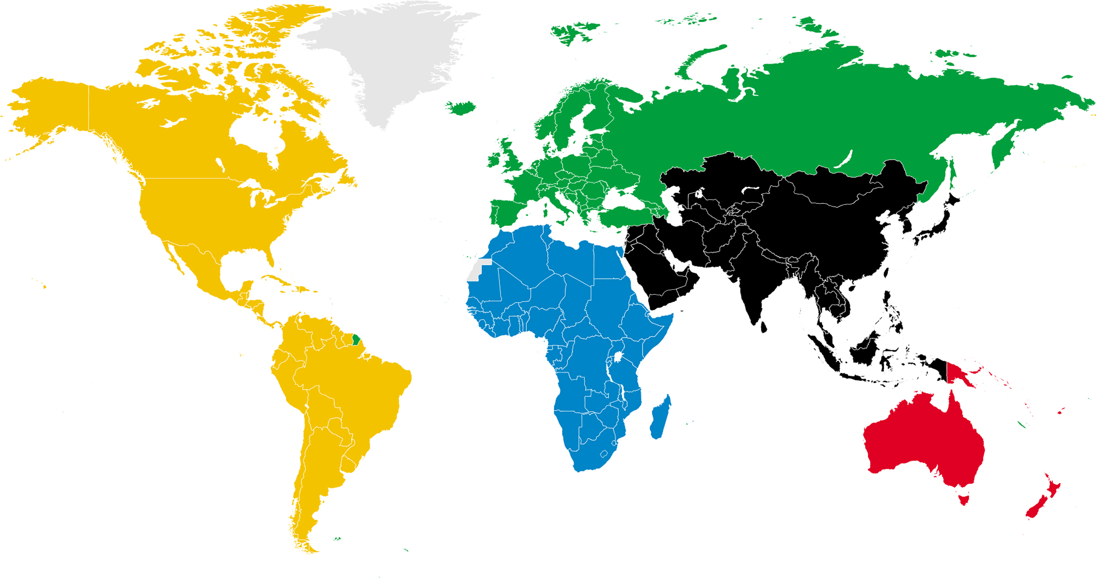










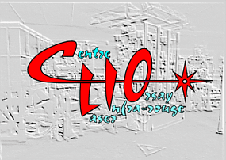















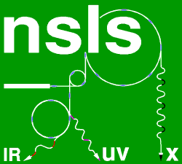
















The International Light Source Community is Growing and Highly Competitive
FLASH
SwissFEL
ELBE
SAGA
Light Source
Indus-1
Indus-2
Notes:
The LS community is large, it continues to grow, it is on the one hand collaborative, but on the other quite competitive. There are very ambitious plans being mounted throughout the world to design and deploy next-generation storage ring technology based on so-called multi-bend achromat (MBA) lattices which hold the promise of two to three order or magnitude enhancements in brightness and coherent flux relative to that which is achieved in 3rd generation light sources.

Slide 35
Distance from Top Light Sources to
Top Supercomputer Centers
Light Source | Distance to Top10 Machine
SIRIUS, Brazil | > 5000Km, TACC, USA
BAP, China | 2000Km, Tihane-2, China
MAX, Sweden | 800Km, Jülich Germany
PETRA III, Germany | 500Km, Jülich Germany
ESRF, France | 400Km, Lugano, Switzerland
Spring 8, Japan | 100Km, K-Machine, Kobe, Japan
APS, IL, USA | ~1Km, ALCF & MCS*, ANL, USA
*ANL Computing Divisions
ALCF: Argonne Leadership Computing Facility
MCS: Mathematics & Computer Science

Slide 36
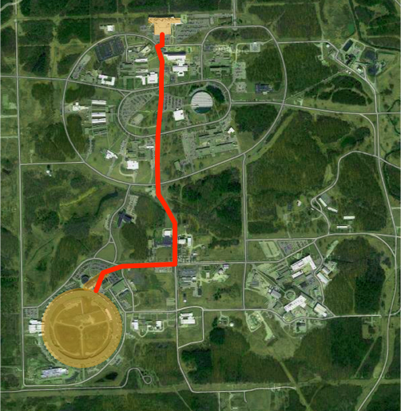
Proximity means
we can closely
couple computing
in novel ways
Terabits/s in the
near future
Petabits/s
are possible
ALCF
MCS
APS

Slide 37
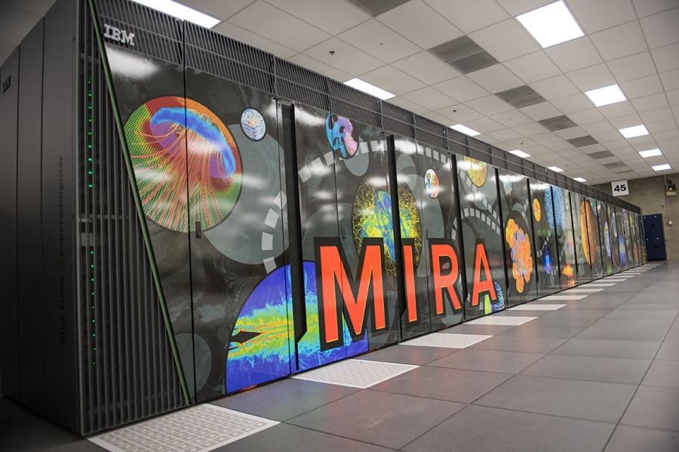
Real-time beamline analysis
Goal: Transfer data from APS to HPC while experiment is running
Use ALCF Mira, an IBM Blue Gene/Q: 786,432 cores @ 10 PF
Challenges
  Data transfer (15 TB / week or more)
  Co-scheduling HPC time with beam time
  Rapidly scaling existing prototypical analysis codes to
  ~100K cores
  Staging experimental data
  (577 MB) from GPFS to the compute nodes
Can use millions of CPU hours
per week!

Slide 38
Data management for the energy sciences
Data management is a DOE-wide problem (not just at light sources)
“Despite the central role of digital data in Dept. of Energy (DOE) research, the methods used to manage these data and to support the information and collaboration processes that underpin DOE research are often surprisingly primitive…”
- DOE Workshop Report on Scientific Collaborations (2011)
Our goals:
  Modify the operating systems of APS stations to allow real-time streaming to a novel data storage/analysis platform.
  Converting data from the standard detector formats (usually TIFF) to HDF5 and adding metadata and provenance, based on the NeXus data format.
  Rewrite analysis operations to work in a massively parallel environment.
  Scale up simulation codes that complement analysis.

Slide 39
ANL: On the Path to Exascale Computing
Since 2007 DOE laboratories have been working with DOE to chart the path to exascale computing (10¹⁸ operations per second)
The President’s 2016 budget requests ~$80M plus up to expand R+D (labs, vendors, universities)
Target is production exascale systems by 2023
Argonne is one of three labs leading this effort
The ALCF at Argonne is a designated site for deployment of the first exascale systems

Slide 40
Diffuse scattering Workflows
Big picture

Slide 41
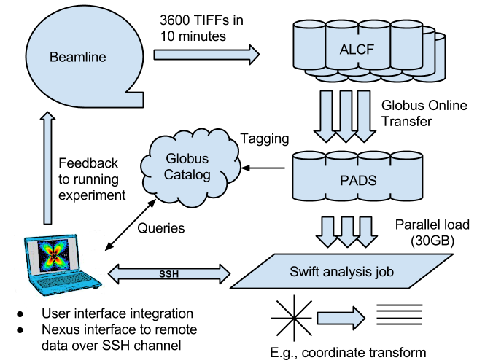
Data ingest/analysis/archive
The October run produced 104 directories containing 5M files totalling about
27 TB.

Slide 42

PADS: Petascale Active Data Store
23 higher-end nodes for data-intensive computing,
repurposed for this work (installed in 2009)
  Each node has 12-way RAID for very
  fast local disk operations
Previously, difficult to use as “Active Data Store”
  Difficult to access specific nodes through PBS scheduler
  No catalog (where is my data?)
  No way to organize/access Data Store!
Solution: Swift/T
  Organizes distributed data using Swift data structures and mappers
  Leaves data on nodes for later access
  Allows for targeted tasks (can send work to node with data chunk)
  Integrates with Globus Catalog for metadata, provenance, archive...
  Combining unscheduled resource access with high performance data rates will allow for real-time beamline data analysis, accelerating progress for materials science efforts

Slide 43

Interactive analysis powered by scalable storage
Replace GUI analysis internals with operations on remote data

Slide 44


Remote matrix arithmetic: Initial results
Initial run shows performance issue: addition took too long
Swift profiling isolated issue: convert addition routine from script to C function: obtained 10,000 X speedup
Swift/T integrates with MPE/Jumpshot and other
MPI-based performance analysis techniques

Slide 45
Light source computing is an end-to-end, multi-scale challenge
We seek new experimental methodologies that involve rapid reconstruction and analysis and computer-in-the-loop control
We also want to address other elements of the end-to-end experiment design, execution, and analysis pipeline: e.g., experiment design and knowledge synthesis

Slide 46
Diffuse scattering workflow overview
Goal: Run scattering experiments with full detector resolution
  Capture and store everything
  Produce archive of raw and intermediate data products
  Automatically move bulk data to processing sites
  Automatically perform data transformations and visualizations
  Perform simulation for inverse modeling
  Contains two HPC subworkflows
Challenges
  Bulk data movement and storage
  Data and metadata management tools
  Easily express and deploy concurrent data processing workflows
  Easily express and deploy scalable programs on HPC
  Connect cluster processing to HPC to visualization

Slide 47

APS workflow diagram

Slide 48

Preliminary results
Workflow was used to process data from beamline experiments in October 2013 and April 2014.
Workflow can keep up with data rates with relatively low concurrency on an analysis cluster
A burst case, such as
re-running a whole
workflow, would use
~100 nodes of the
cluster.

Slide 49
CCTW
Crystal Coordinate Transformation Workflow
Collaboration with Guy Jennings

Slide 50
Crystal Coordinate Transformation Workflow
Goal: Transform 3D image stack from detector coordinates to real space coordinates
  Operate on up to 50 GB data
  Relatively light processing – I/O rates are critical
  Core numerics in C++, Qt
  Parallelism via Swift
Challenges
  Coupling C++ to Swift via Qscript
  Data access to HDF file on distributed storage

Slide 51

CCTW diagrams

Slide 52

CCTW: Swift/T application (C++)
bag<blob> M[];
foreach i in [1:n] {
  blob b1= cctw_input(“pznpt.nxs”);
  blob b2[];
  int outputId[];
  (outputId, b2) = cctw_transform(i, b1); foreach b, j in b2 {
  int slot = outputId[j];
  M[slot] += b;
  }}
  foreach g in M {
  blob b = cctw_merge(g); cctw_write(b);
  }}

Slide 53
DIFFEV
Diffuse Scattering Evolutionary Algorithm
Collaboration with Reinhard Neder (Erlangen)

Slide 54
DIFFEV overview
Goal: Obtain crystal structure model that fits experiment
  Use iterative, evolutionary population of simulations
    Run simulation batch
    Compare simulated result to experiment
    Select new population members
    Repeat
Challenges
  Integrate Swift, Fortran, Python, and an ad hoc Fortran-based macro language
  Run at up to 100,000 cores

Slide 55

DIFFEV: Scaling Crystal Diffraction Simulation
Determines crystal configuration that produced given scattering image through simulation and evolutionary algorithm
Swift/T calls DISCUS via Python interfaces
Wozniak et al. Interlanguage parallel scripting for distributed-memory scientific computing. Proc. WORKS @ SC, 2015.

Slide 56

DIFFEV: Genetic algorithm via dataflow
Novel application composed from existing libraries by domain expert!
Potential concurrency:
100,000 cores
Application by
Reinhard Neder

Slide 57

DIFFEV output

Slide 58

DIFFEV: Preliminary Results
Runs well up to 512 cores so far
Difficulty compiling on HPC machines
Demonstrates strength of rapid development in Swift

Slide 59
NF-HEDM
Near Field – High Energy Diffraction Microscopy
Collaboration with APS Sector 1: Jon Almer, Hemant Sharma, et al.

Slide 60
Sharma workflow overview
Goal: Speed up experimental calibration/analysis loop
  Analysis of polycrystalline aggregates
  Obtain grain size, shape, orientation, shape
  Accelerate/automate data processing from c. 2 years down to minutes
  Reduce sparse data sets by factor of 1000 on APS cluster
  Send reduced data to Blue Gene/Q for stress/strain analysis
Challenges
  Couple Swift/K cluster workflow with Swift/T HPC workflow (BG/Q)
  Perform bulk data movement between workflows and across filesystems over Globus

Slide 61

NF-HEDM

Slide 62

Sharma: Preliminary results
First workflow to use Swift/K and Swift/T
Generally new application C code- easy to run on Blue Gene
Swift/K component scales to 320 cores on APS cluster
Swift/T scaling results forthcoming on Blue Gene/Q
  Preparing for real-time run in July 2014

Slide 63







HEDM at APS – find crystal structure of metals, non-destructively

Slide 64
High-Energy Diffraction Microscopy
Near-field high-energy diffraction microscopy discovers metal grain shapes and structures
The experimental results are greatly improved with the application of Swift-based cluster computing (RED indicates higher confidence in results)
October 2013: Without Swift
April 2014: With Swift

Slide 65

Task-based HPC
Existing C code (NFHEDM) assembled into scalable HPC program with Swift/T
Problem: Each task must consume ~500 MB of experimental data – each task does uncoordinated I/O

Slide 66

Intended use of broadcast operation
Grain orientation optimization workflow runs on BG/Q once data is there
Each task needs to read all input from a given dataset
Desire to use MPI-IO before running tasks

Slide 67
NF-HEDM application Swift code
Swift script
Swift I/O hook specification
parameterFile = argv("p");
microstructureFile = argv("m");
start = toint(argp(1));
end = toint(argp(2));
foreach row in [start:end] {
FitOrientation(parameterFile, row,
microstructureFile);
}
broadcast to /tmp files {
~/dataset-1/*.cfg
}
broadcast to /tmp/bulk files {
~/dataset-1/bulk/file1.index
~/dataset-1/bulk/file2.index
~/dataset-1/bulk/*.bin
}
FitOrientation() is linked to a C function
Each task reads the same data
Output is inserted into the microstructure
file
Executed by Swift at startup

Slide 68

Big Data Staging with MPI-IO
Solution: Broadcast experimental data on HPC system with MPI-IO
Tasks consume data normally from node-local storage

Slide 69

Scalability result: End-to-end
101 GB/s
21 GB/s
8K cores

Slide 70

Scalability result: Stage+Write
134 GB/s
8K cores
This plot breaks I/O hook into 1) stage+write and 2) read phases
Read phase is node-local: consistently 10.8 ±0.1 s

Slide 71
Big Data Staging: Conclusions
Blue Gene/Q can be used for big data problems and a many-task programming model
  Just broadcast the data to compute nodes first with MPI-IO
The Swift I/O hook enables efficient I/O in a many-task model
  Reduces I/O time by factor of 4.7!
Connecting HPC to a real-time experiment saved an experiment by detecting a loose cable
Code is now being reused by about 5 different groups
  Now must accommodate extra users on HPC resources!

Slide 72





NeXpy: A Python Toolbox for Big Data
A toolbox for manipulating and visualizing arbitrary NeXus data of any size
A scripting engine for GUI applications
A portal to Globus Catalog
A demonstration of the value of combining:
  a flexible data model
  a powerful scripting language
http://nexpy.github.io/nexpy
$ pip install nexpy
=
+

Slide 73

Mullite

Slide 74


NeXpy in the Pipeline
Use of NeXpy throughout the analysis pipeline

Slide 75

The NeXus File Service (NXFS)
Wozniak et al. Big data remote access interfaces for light source science. Proc. Big Data Computing, 2015.

Slide 76



NXFS Performance
Faster than application-agnostic remote filesystem technologies
  Compared Pyro to Chirp and SSHFS from inside ANL (L) and AWS EC2 (W)
Plus ability to invoke remote methods!
File open (10⁻¹s)
Metadata read (10⁻²s)
Pixel read (1s)
Operation and Time Scale

Slide 77
CHESS Trip: Scientific Overview
Running on A2 beamline
Using the Pilatus 6M detector
Using large X-ray energy range and low temperature
Using high energy (> 50 keV) to cover large range of reciprocal space
Studying relaxor ferroelectrics, e.g., Pb(Mg_{1/3} Nb_{2/3})O₃
  Ergodic at warm temperatures
  Nonergodic at very cold temperatures
  Strongly temperature dependent, anisotropic diffuse scattering around Bragg peaks
Flexing our pipeline tools at another facility- how can we generalize these techniques?

Slide 78

Ad Hoc CHESS Pipeline

Slide 79
Summary
Swift: High-level scripting for outermost programming constructs
Described multiple challenging Big Data + HPC applications from X-ray crystallography
Thanks to the organizers
Thanks to the Swift team
Thanks to our application collaborators
Questions?
http://swift-lang.org
http://mcs.anl.gov/exm

