Slide 1
Case Studies in Storage Access by Loosely Coupled Petascale Applications
Justin M Wozniak and Michael Wilde
Petascale Data Storage Workshop at SC’09
Portland, Oregon – November 15, 2009

Slide 2
Outline
Scripted scientific applications
Overview of parallel scripting
I/O challenges
Existing solutions and related work
Collective data management
Communication and I/O model
Basis and theoretical benefit
Case studies
High-level features
Look for well-studied patterns
Summary

Slide 3
Scripted applications
Development timeline:
Scientific software developer produces sequential code for application research
Produces small batch runs for parameter sweeps, plots
Small scale batches organized through the shell and filesystem
This model scales up to about an 8 node cluster
Additional scaling possible through the application of grid tools and resources
☞ What if the application is capable of (and worthy of) scaling further?
Notes:
Note how much of the timeline is based on scripting

Slide 4
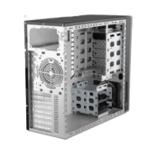
Swift and related tools
Separate workflow description from implementation
Compile and generate workloads for existing execution infrastructures
<sites.xml>
…
rawdata = sim(settings);
stats = analysis(rawdata);
…
write script
select resources
allocate resources
compile
 execute
Notes:
Sit back and wait for results – and I mean wait

Slide 5
Default I/O
In a standard Swift workflow, each task must enumerate its input and output files
These files are shipped to and from the compute site
compute
copy inputs

submit site
return outputs
This RPC-like technique is problematic for large numbers of short jobs
Notes:
Explain default Swift I/O – wrapper script

Slide 6
Data generation and access
Current I/O systems work recognizes the challenges posed by large batches of small tasks
Characterized by:
Small files
Small, uncoordinated accesses
Potentially large directories
Whole file operations
Metadata operations
File creates
Links
Deletes
Overall challenges
BlueGene/P:
I/O bandwidth: down to 400 KB/s /core
File creation rate: only 1/hour /core (Raicu et al.)

Slide 7
Related work
Filesystem optimizations
PVFS optimizations for small files (Carns et al. 2009)
Improved small object management
Eager messages
BlueFS client optimizations (Nightingale et al. 2006)
Speculative execution in the filesystem client
Mitigates latency
Scheduling and caching
BAD-FS (Bent et al. 2004)
Data diffusion (Raicu et al. 2009)
Collective models
Enable programmer support
Borrow from strengths of MPI, MPI-IO functionality
Expose patterns explicitly (MapReduce, etc.)

Slide 8
Collective Data Management
Provide primitives that the programmer can use explicitly
May already be used via custom scripts
Generally difficult to specify with sequential languages
Broadcast (aggregation, map):
⇨
Scatter (two-phase):
⇨
Gather (aggregation, reduce)
 ⇦




Slide 9
Cache techniques
Cache pinning (specify critical data)
 ⇨ ⇨
Workflow/data-aware scheduling
⇦  ⇨



time
Notes:
A continuum of

Slide 10
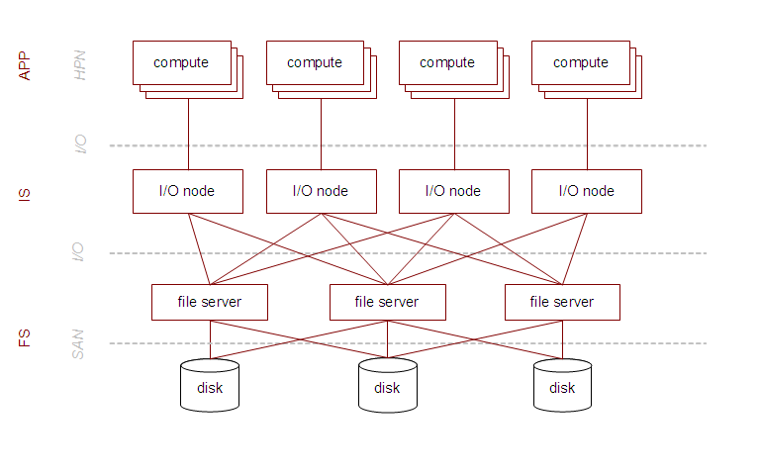
I/O reduction
Let applications continue to move large quantities of small data over POSIX interfaces
Prevent these accesses from reaching the filesystem
CDM
User I/O
Notes:
Reiterate default I/O setup - Normal user small I/O incurs latency over multiple hops – Swift directory naming

Slide 11
I/O reduction
The purpose of each potential CDM technique is to reduce accesses to the filesystem
In our case studies, we sought to estimate the maximum possible reduction that a carefully-written application could achieve on our target system model
In a default scripted workflow, all accesses go to the FS
As a start, we used an I/O reduction defined as:
in bytes
Other interesting quantities could measure file creates, links, or a count of accesses regardless of size
Notes:
Note latency as possible challenge – in directory ops as challenge, even in PVFS

Slide 12
Case studies: High-level view
OOPS: Open Protein Simulator
DOCK: Molecular docking
BLAST: Basic Local Alignment Search Tool
PTMap: Post-transformational modification analysis
fMRI: Brain imaging analysis

Slide 13
fMRI
Simple MapReduce-like structure
Broken down into scatter and gather operations
Intermediate data can be cached. Produces much final output
Notes:
Simple MapReduce pattern translated to scatters and gathers

Slide 14
BLAST
Like MapReduce with two inputs
If cache is used to implement broadcast, must prevent pollution
Produces trivial final output – I/O reduction may exceed 99%

Slide 15
DOCK
Significant input size
Pipeline-like accesses
Produces trivial final output – I/O reduction may exceed 99%

Slide 16
OOPS
Significant input size
Pipeline-like accesses and iterations
Produces trivial final output – I/O reduction may exceed 99%

Slide 17
PTMap
Pipeline-like accesses and iterations
Uses links to create an intermediate index
Produces trivial final output – I/O reduction may exceed 99%

Slide 18
Observations
Great deal of potential optimizations
Many of which are previously studied
Difficult to implement with sequential programming models
Small files
Large input data sets must be read efficiently
Many small files are created, written once, and possibly read again multiple times, primarily by transmission to other compute jobs
Developer basically knows this – must be able to express it
Patterns
MPI-like concepts such as broadcasts, gathers, and even point-to-point messages help describe the I/O patterns
Can be exposed to the developer through scripting abstractions

Slide 19
Summary
Investigated I/O performance characteristics of five scalable applications
Laid out workflow job/data dependencies
Compared with well-studied patterns
Performed coarse studies of file access statistics
Looked at idealized potential optimizations (gedankenexperiments)
Portability
Running on the BG/P not unlike running on the grid
Benefit from existing software systems
Work within the typical scientific development cycle
Lots to do
Proposed new software toolkit and language integration
Largely based on existing tools; package and expose to developers

Slide 20
Thanks
Application collaborators: Aashish Adhikari (OOPS) and Sarah Kenny (fMRI)
Mihael Hategan (Swift, Coasters, Java CoG), Allan Espinosa (BLAST), Ioan Raicu (Falkon)
Rob Ross
Thanks to the reviewers
Grants: This research is supported in part by NSF grant OCI-721939, NIH grants DC08638 and DA024304-02, the Office of Advanced Scientific Computing Research, Office of Science, U.S. Dept. of Energy under Contracts DE-AC02-06CH11357 and DE-AC02-06CH11357. Work is also supported by DOE with agreement number DE-FC02-06ER25777.

Slide 21
Questions

