Slide 1
Tracking Dubious Data: Protecting Scientific Workflows from Invalidated Experiments
TRACKABLE PREDICTIONS in machine-controlled experiments
drhgfdjhngngfmhgmghmghjmghfmf
Presenter: Justin m wozniak Co-Authors: Jim Pruyne and Ian Foster
Data science & Learning Argonne National Laboratory
ReWorDS Workshop @ eScience
October 12, 2022

Slide 2
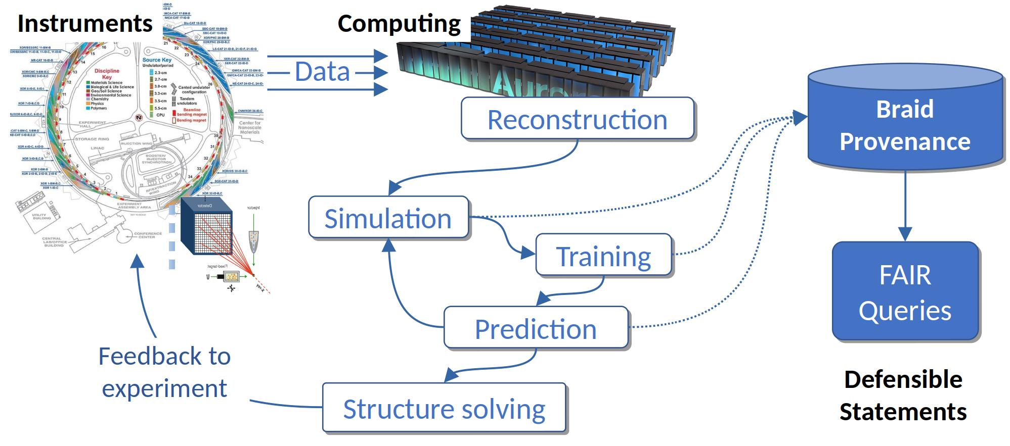
BRAID-DB CONCEPTUAL OVERVIEW
Toward self-documenting AI-driven experimental science
Motivation: Need automation via machine learning methods to enable automated, policy-driven experiment control and steering, but this raises challenges in debugging, diagnosis, validation, and controlling for bias
Need to develop new provenance methods to track the impact of AI-driven decisions that are themselves based on models generated by workflows - tracking ML model exposure to all data sources (e.g. other ML models) is complex
Goal: Make automatic decisions interpretable, explainable, and subject to ongoing validation checks and revisions
System consists of a workflow-accessible API for tracking workflow products, including ML models
Models can be retrained, revised, and invalidated

Slide 3
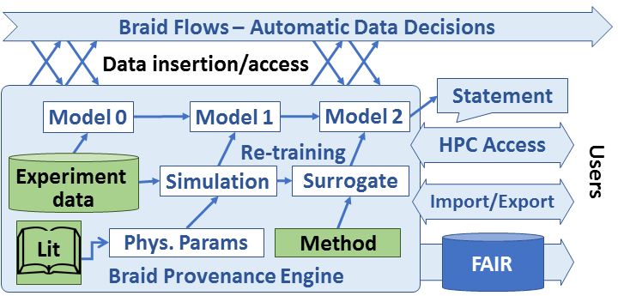
Braid Provenance GOALS
Capture provenance needs of
Embrace automation in data analysis, retention, decision-making
Enable users to trace back to how decisions were made
Necessitates recording what went into model training, including external data, simulations, and structures of other learning and analysis activity
Envision a versioned database for ML model states with HPC interfaces
Integrate with other Braid components

Slide 4
Braid provenance features
Accelerate interpretable ML-driven science
Embrace automation in how and when to analyze and retain data, and when to alter experimental configuration
Automate also the record-keeping so that humans and/or machines can recover how a particular result was obtained
When failures occur, diagnose causes, enable rapid restart
Develop recursive and versioned provenance structures:
Models may be constructed via other models (estimates, surrogates)
Models are constantly updated (track past decisions and allow updates)
Enable runs at scale: CANDLE reference example:
One training epoch is completed per node every five minutes.
On an exascale system of 10K nodes, that is 33 records/second
Ensure capacity for a week’s worth of experimental data collection
Be comprehensive: capture data transformations through to publication
Build toward defensible automated statements: tools for AI science

Slide 5
BRAID-DB Concepts
Approach: mix and match concepts from the provenance literature with popular version control concepts to provide a robust and usable solution
Developing small SQL database with high-level Python API
Braid data types:
Facts: External, static data. E.g., reference data, software
Records: Data produced by Braid-visible processes
Models: Versioned objects that depend on Facts, Records, and other Models
Statements: Externally visible inferences and predictions
Plan to keep core data structures simple, while offering interfaces and interoperation for local, wide area, and HPC infrastructures

Slide 6
Braid provenance prototype
Prototype Python/SQL implementation for initial tests
Simple client/server model for initial evaluation and requirements testing
Usable on one site at a time with import/merge tools for multi-site cases
Abstraction over Postgres/SQLite as needed for site restrictions
Provide API that can be integrated into workflow frameworks or called directly
Applications and/or workflow systems
Optional HPC cache
Import/merge tools
Recursive, versioned model record structures
Data storage model
Postgres
SQLite
Other?

Slide 7
PROVENANCE Subproject MILESTONES
Survey about 3 “key apps” for use cases and requirements
Construct synthetic “Mascot” app to flex data structures and performance
Iterate to maintain compatibility with other Braid products and FAIR conventions
Investigate efficient representations of versioned ML state
Achieve target performance metrics (33 records/second, 20M records/week)
Circle back to key apps for validation
Develop cloud-hosted service based on Globus Auth, Flows

Slide 8
partner applications
Initial collaborations with skeleton workflows
SLAC FPGA workflow
Goal: Perform data reduction at the edge
Scientist configures experiment parameters
Workflow launches simulations with experiment parameters
Complete simulations by time experiment data collection is complete
Train model on simulation and experiment data
Run model on an FPGA to perform data reduction in production
BraggNN workflow
Goal: Improve peak finding
Train model to represent Bragg peaks
APS collects raw scattering data
Run peak finding on raw data, label peaks
Train model on peaks to represent raw data
Reproduce and save peak locations
SSX workflow
Goal: Track the provenance of SSX crystal structures
Structures can come from multiple experiments
Analysis is performed on the input data using these configs to create int files
The int files are used to create a structure
Track experimental config files and derived structures
CTSegNet workflow
Goal: Track the history of various U-Net-like models used for trial-and-error image segmentation
Obtain tomo scan
Perform image processing, contrast adjustment, etc.
Apply (labeling) "masks"
Run ensemble models in inference mode
Get new segmentations
Aggregate segmentation results
Re-train models and loop…​
Samarakoon/Osborn workflow
Goals: Fit simulated crystal structure to scattering data
Obtain neutron scattering data
Train and apply auto-encoder to identify important features
Apply dimensionality reduction
Fit to data, repeat until convergence

Slide 9
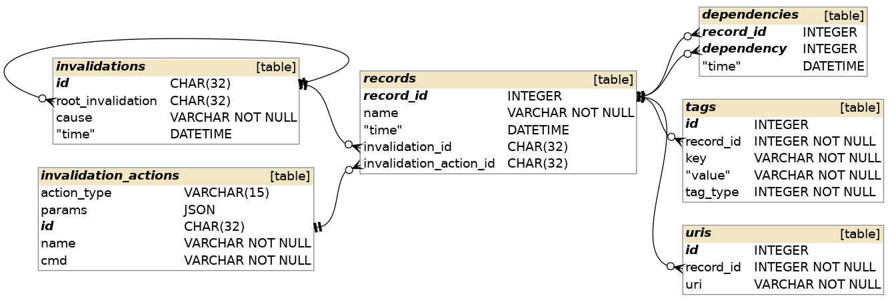
BRAID-DB MODEL CONCEPTS
Braid data types (enforced at the API layer):
Facts: External, static data. E.g., reference data, software
Records: Data produced by Braid-visible processes
Models: Versioned objects that depend on Facts, Records, and other Models
Statements: Externally visible inferences and predictions
New stuff:
Invalidate IDs, causality history- enables invalidation queries and actions
Notes:
To discuss:
Dependency forms a DAG
We can enforce no cycles with a bit of extra tracking
Tags provide a simple grouping/query mechanism

Slide 10
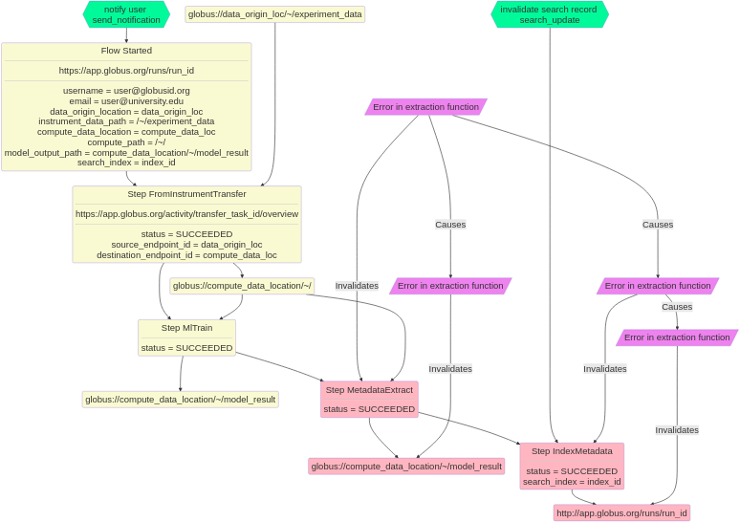
BRAID-DB: DATA AND MODEL INVALIDATION
Managing ML models as experimental data is collected
Braid-DB tracks workflow steps and their data input/output dependencies, initially assuming all are valid/reliable
Invalid ML models can influence workflow decisions, data collection limits, simulation parameters, etc.
When experimental computation or data is found to be invalid, all affected downstream artifacts can be flagged
Invalidation of an element may trigger actions including deletion, recomputation, retraining, or simple note-taking
High-quality record-keeping is essential for AI-driven science, otherwise it will be impossible to validate AI workflow outputs
Rectangles: Flow step records: data transfer, training, etc.
Pink parallelograms: Invalidation records
Notes:
The legend of the diagram as follows:
rectangles (yellow or pink) represent steps of a flow or data dependencies / outputs – These are “records”
A green hexagon represents an “invalidation action”: a trigger to be fired if the associated record should be invalidated
Purple(ish) parallelograms represent assertions that a record is invalid. Invalidation is established by user/API calls to the Braid-DB
Invalidations propagate down the dependency hierarchy with tracking of “invalidation provenance” (i.e. a downstream invalidation keeps track of the source that caused it to be invalid). Seen in diagram as links between the parallograms.
In the event a record is invalidated, if it has an associated invalidation action, the action will be performed.
Thus, invalidation detection and invalidation trigger are decoupled.

Slide 11
CONCLUSION
Toward AI-enhanced, self-documenting experimental science
Need to develop new methods to enable policy-driven automation of the flows used to collect, analyze, organize, and learn from data
Orchestrate data flows using modular and repurposable actions; integrate with HPC resources
Enforce data policies, i.e., data capture quality and performance
Make automatic decisions interpretable, to understand progress and policy adherence (this talk)
Braid Team: Ian Foster (PI), Tekin Bicer, Ben Blaiszik, Kyle Chard, Ryan Chard, Raj Kettimuthu, Bogdan Nicolae, Jim Pruyne, Justin Wozniak
Facility
Braid Flows
HPC
FAIR Records

Slide 12
QuestionS?
Thanks to the organizers
Braid project: https://anl-braid.github.io/braid
Braid-DB software and tests available at: https://github.com/ANL-Braid/DB
Ongoing ideas:
Integration with workflow systems (currently totally independent)
Other experimental science applications
Other underlying versioned databases

