Slide 1
ASCR Applied Math Program Nursery for DOE Simulations
Collaborations are informal and often spontaneous, but over the long term have the largest impact. ASCR applied math is the only program that supports the genesis of these activities.
Collaborations have evolved to produce profound impacts on DOE computational science in ways that were not originally anticipated.
PETSc developers interact with diverse applications teams in
DOE Office of Science (ASCR, BES, BER, FES, HEP, NP)
Other DOE offices (NNSA, FE, NE, EM)
Other scientific areas (DOD, industry, international projects, etc.)
We now present several efforts covered by funding 10-15 years ago that demonstrate the importance of the ASCR Applied Math Program’s support of basic research and how it leads to long-term results.

Slide 2
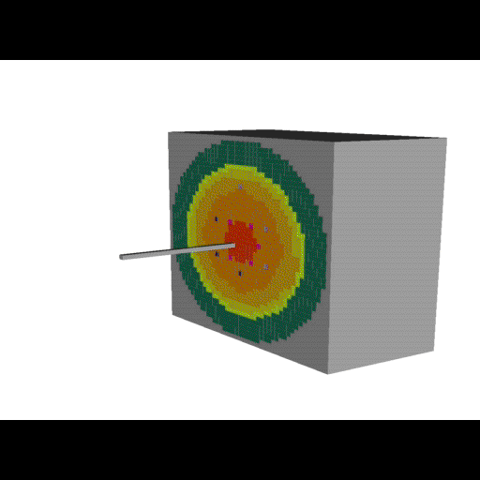
UNIC: Neutron Transport
1996: Graduate student Dinesh Kaushik works with Bill Gropp and Barry Smith to develop a distributed memory version of the NASA aerodynamics code FUN3d.
1999: PETSc-FUN3d wins a Gordon Bell special prize for scaling to over 6,000 cores on the SNL ASCI Red machine.
2009: The NE-funded PETSc-based UNIC neutron transport code, developed by Dinesh and Michael Smith (NE), is a Gordon Bell finalist for scaling to 290,000 cores of the Cray XT5 and IBM BlueGene/P.
Impact: UNIC provides the first high-fidelity neutronics simulations of an entire reactor fuel assembly, now used in the proposed DOE NE co-design center.

Slide 3
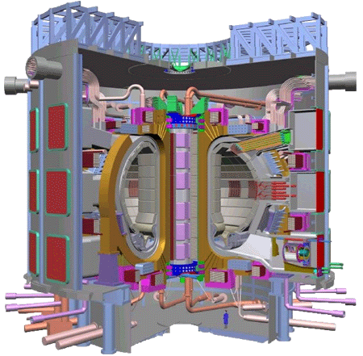
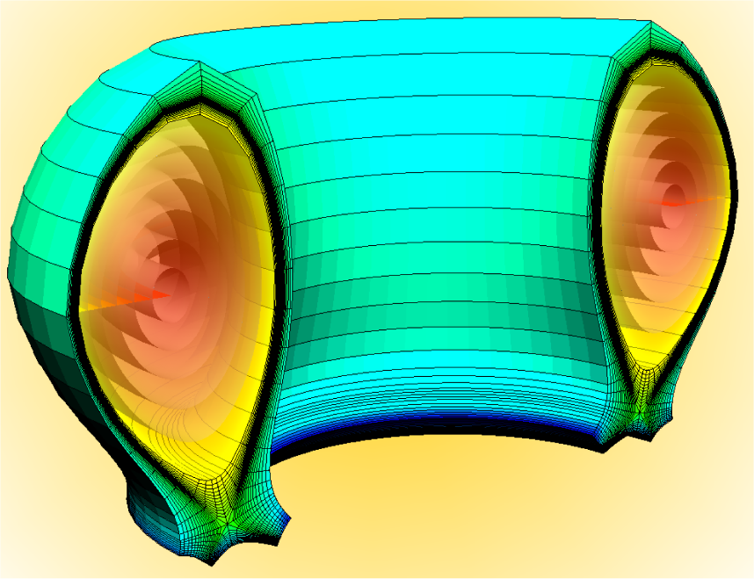
Fusion Energy
1998 Xianzhu Tang (working with Steve Jardin) (PPPL) begins developing M3D, a fully implicit MHD code using PETSc, communicating with Lois McInnes.
1998-2011: PETSc team assists developers of diverse fusion applications (FACETS, GTS, M3D, NIMROD, UEDGE, etc.) in incorporating, tuning, and extending PETSc to achieve efficient, robust, and scalable performance.
Impact: FES: PETSc enables large-scale fusion simulations by the DOE community that support modeling for the International Thermonuclear Experimental Reactor (ITER) project, a collaboration to build the first fusion science experiment capable of producing a self-sustaining fusion reaction.
PETSc provides nonlinear solvers in parallel core and edge transport components, which FACETS has coupled in simulations of H-mode pedestal buildup in the DIII-D tokamak.
ITER

Slide 4
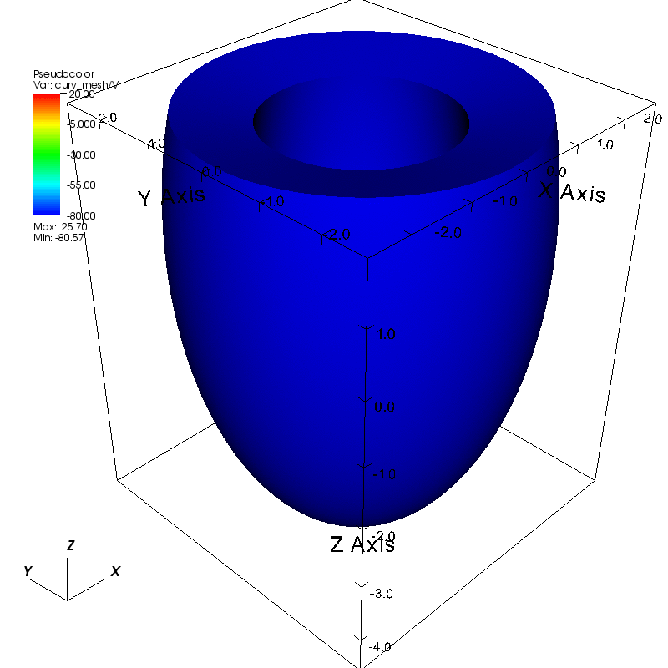
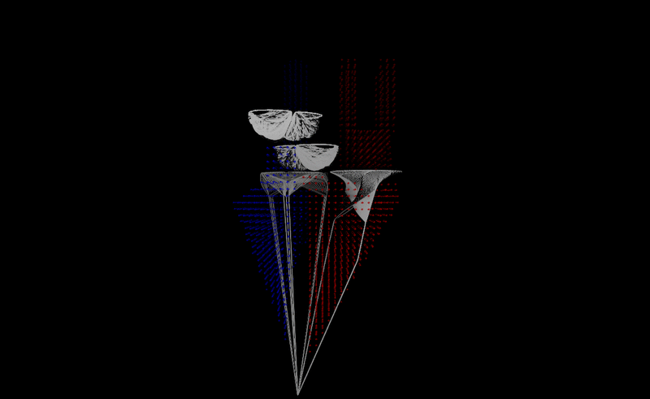
IBAMR: Cardiac Simulations
1998-99: Undergraduate student Boyce Griffith begins using PETSc for biological applications and communicates with Barry Smith.
2011: Griffith, an alumnus of the DOE CSGF program and now on the faculty at NYU School of Medicine, develops Charles Peskin’s early 1970’s ideas on the immersed boundary method into a flexible software suite that employs PETSc, hypre, and SAMRAI.
Impact: IBAMR provides complete heart simulations, with coupled fluid, mechanical, and electrical models.

Slide 5
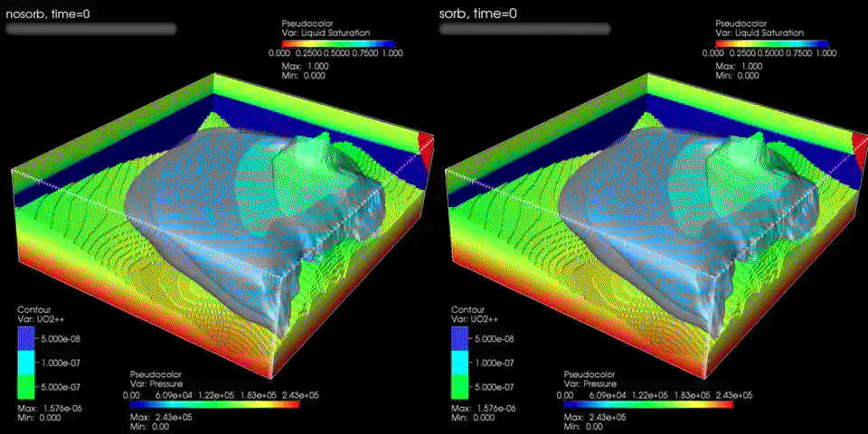
PFLOTRAN: Subsurface flow
2000: CSGF fellow Glenn Hammond (also 2003 CSGF fellow Richard Mills) works with Peter Lichtner (LANL) on “Parallel Reactive Transport Modeling Using the PETSc Library”, in loose collaboration with Barry Smith.
2011: SciDAC application and consistent INCITE awardee PFLOTRAN runs scalably on up to 30,000 cores of the Cray XT5 and IBM Blue Gene/P.
Impact: BER: Modeling multiscale subsurface processes is crucial for accurate predictive capability of contaminant transport and allows quantitative understanding of radionuclide migration at the DOE Hanford facility.

Slide 6
SLEPc: Scalable Eigenvalues
2001: Jose Roman visits ANL to implement modern eigenvalue solver algorithms using the PETSc linear solvers with Barry Smith.
2011: Jose leads the development of SLEPc, the most comprehensive eigenvalue software package, used in dozens of applications.
Impact: SLEPc provides large-scale eigenvalue computations in areas such as neutron diffusion, electromagnetics, chemistry, materials science, acoustics, flow stability, statistics, model reduction and plasma physics for ITER.
Fusion: eigenmodes of electrostatic potential

Slide 7
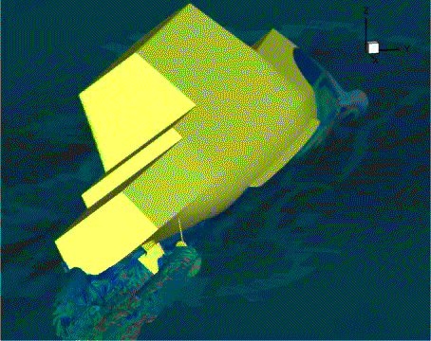
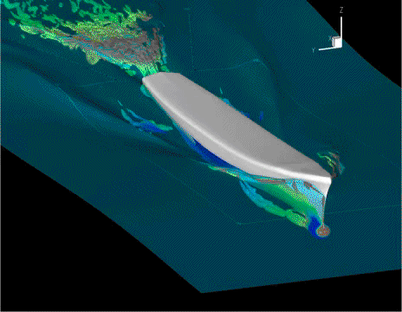
CFDShip-Iowa: Naval Hydrodynamics
2002: Pablo Carrica visits Barry Smith at ANL to understand how PETSc could be used as a pressure solver.
2011: CFDShip-Iowa simulates full naval crafts including propellers and attachments on DOD HPC computing systems.
Impact: CFDShip-Iowa provides a safer, less expensive way to design modern high-performance naval vessels, that requires less “build and test” stages to find out how vessels will perform under real-live conditions.

